Slide 1
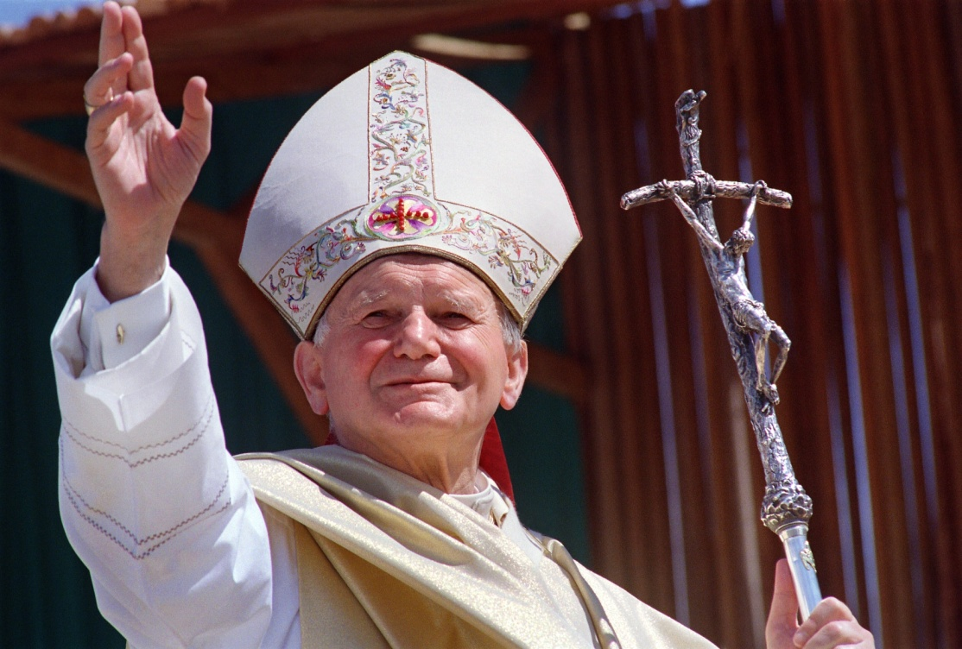
ENVISION: THEOLOGY OF THE BODY FOR MIDDLE SCHOOL
Seventh Grade Curriculum 1.1
Who am I? Discovering My Identity, Purpose, & Destiny

Slide 2
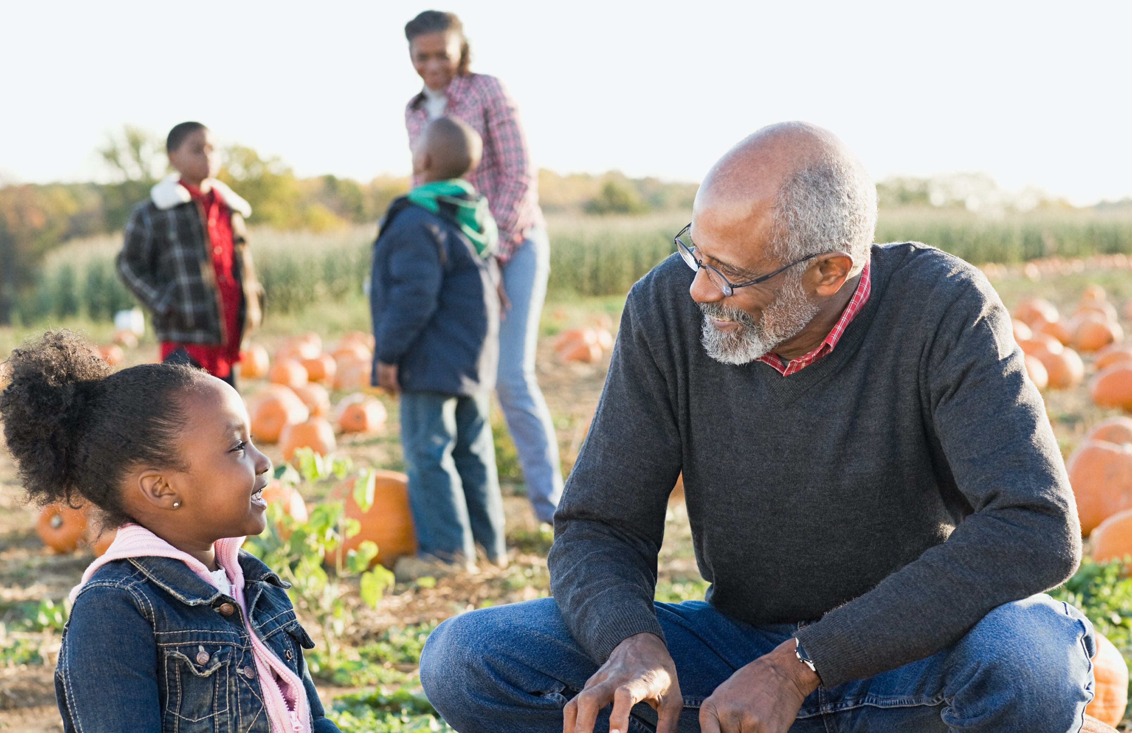
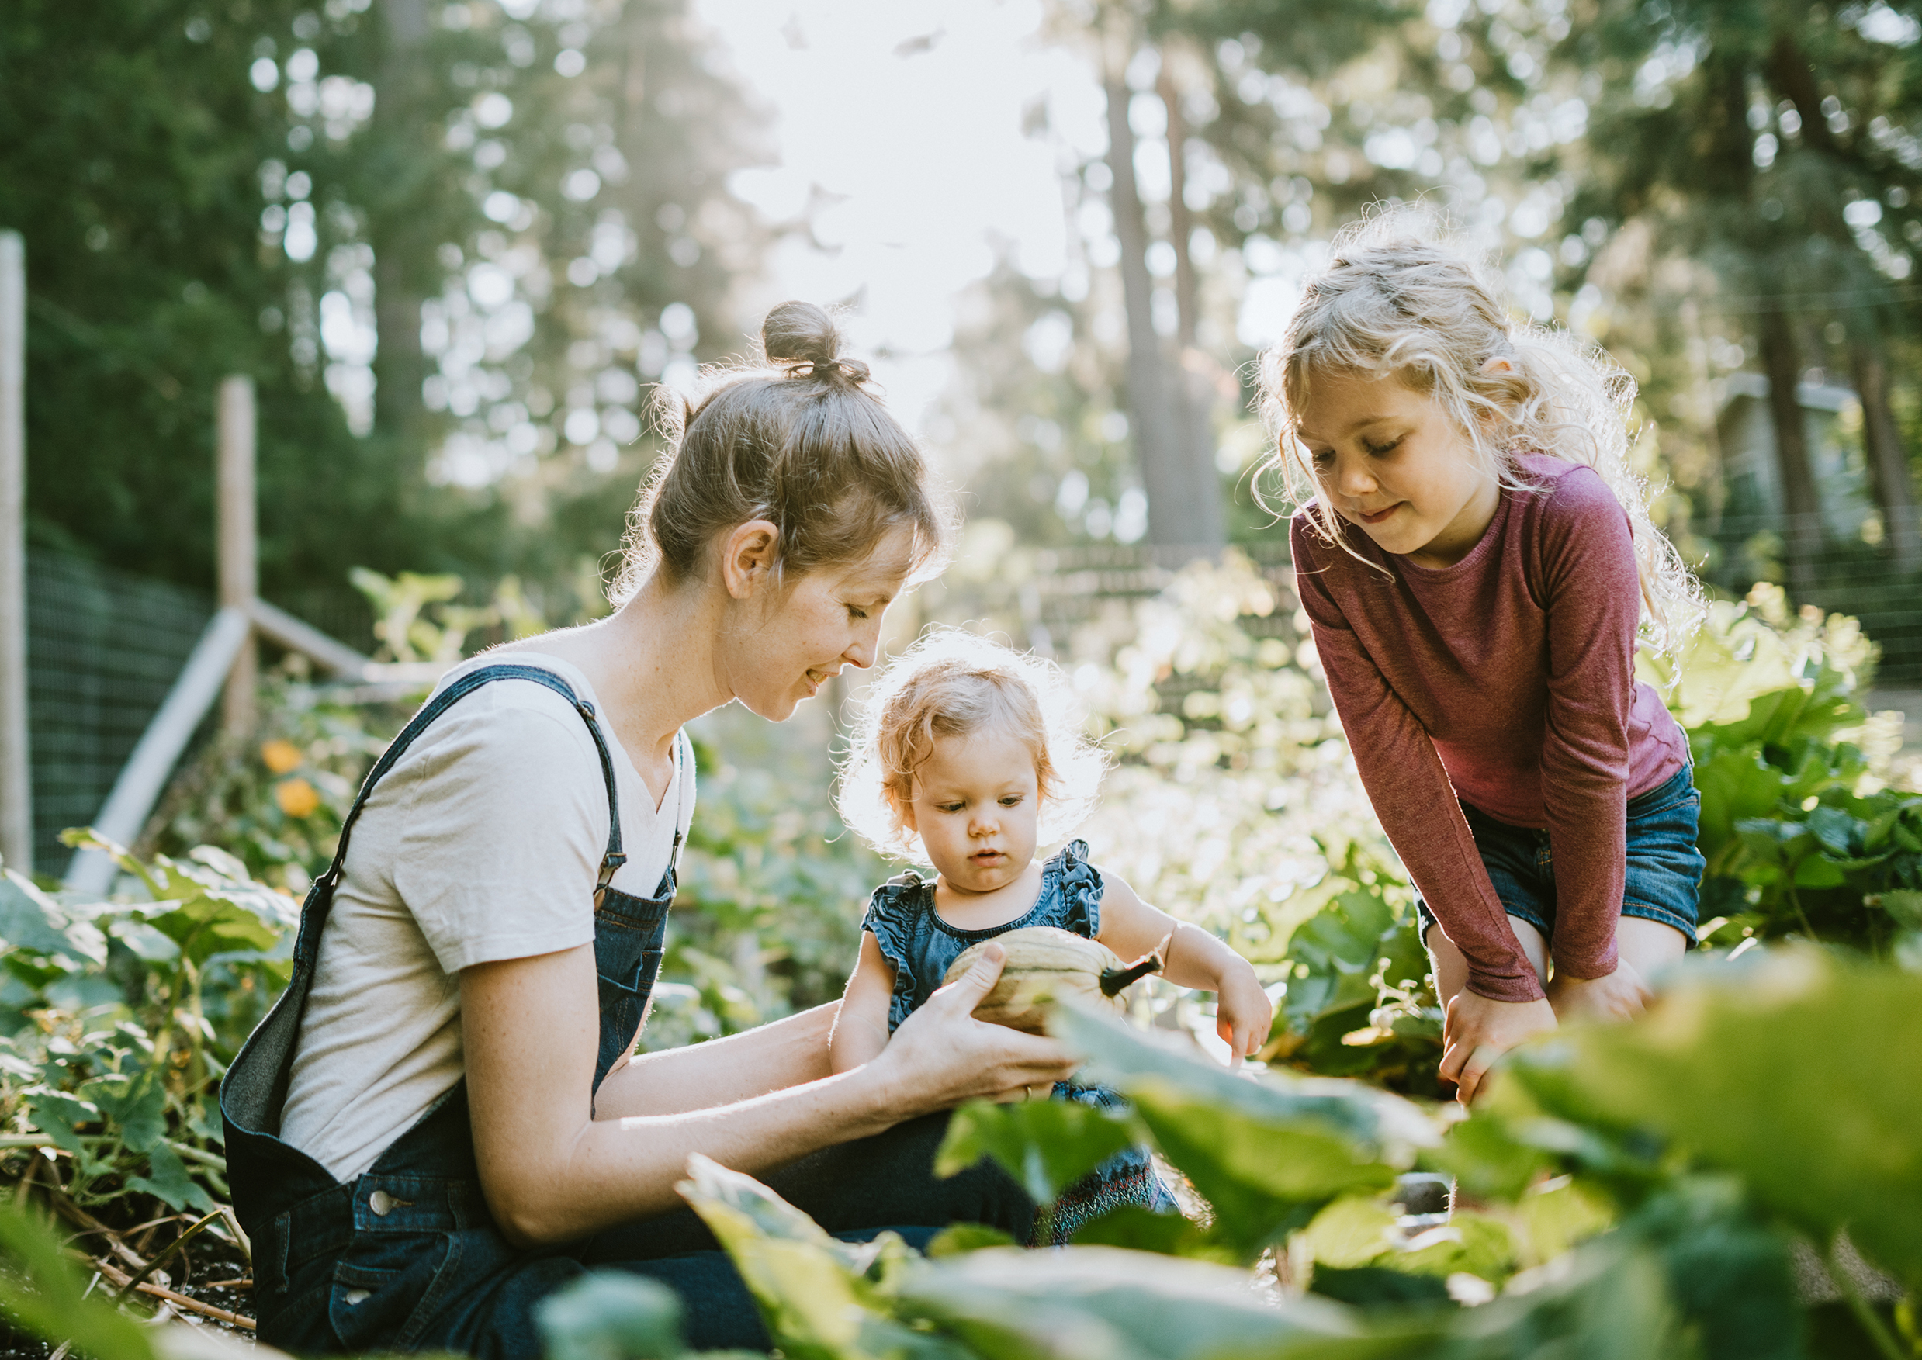

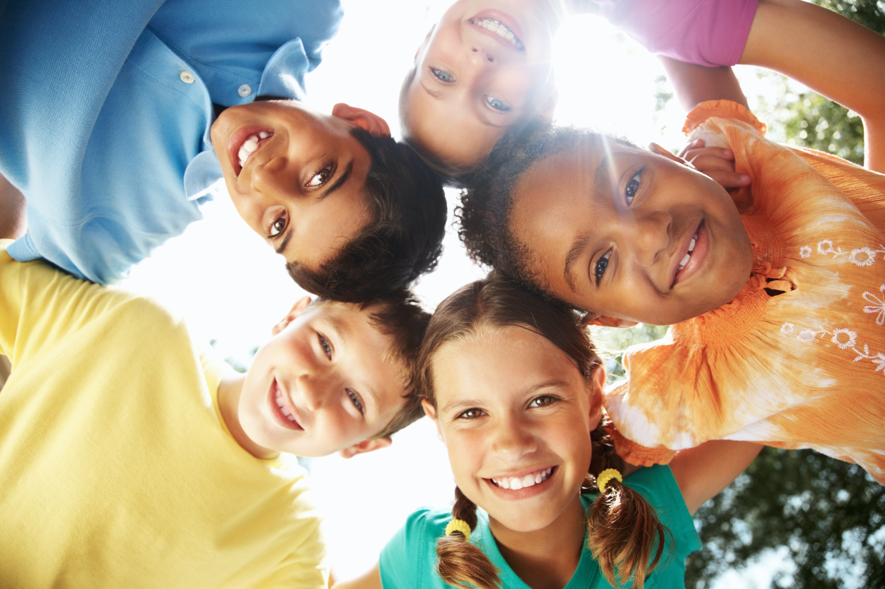
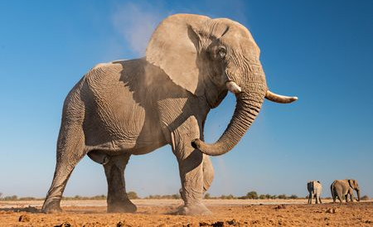
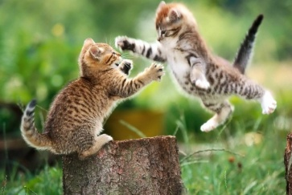
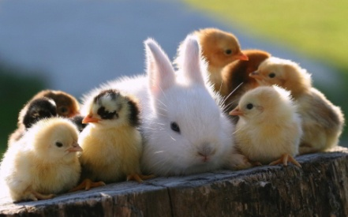
Bellwork
1. A relationship that is important to my identity is…
2. Something that makes human beings different from animals is…
Notes:
These questions can also be found in the “If you ask me” section on pg. 9

Slide 3
OPENING PRAYER
Leader: In the name of the Father…
All respond: In the divine image, Lord, You created him; male and female you created them.
Leader: Lord, you made us body and soul for relationship. You created us from love and for love without anything to hide from you. God, you made us to be happy with you forever.
Jesus, you taught us to address your Father as you did, and so, in the Holy Spirit, we pray,
All: Our Father…

Slide 4
STORY STARTER, pg. 6

Slide 5
IF YOU ASK ME…
Jot down your answers and discuss:
1. If I had to leave home tonight and could take only take one thing with me, I would take ________________.
2. If I were on my own, one house rule I would not follow is ___________________.
3. I think what everyone really wants most is_________________.
4. I think the reason God made us is ___________________.

Slide 6


VIDEO 1 : INTRODUCTION
Who are you? How would you describe yourself without saying your name?

Slide 7
VIDEO 2: TO THE CORE
True or False: “Who we are” refers to who likes or dislikes us.
You cannot make God love you any more than he does right now.
True or False: The more you love others, the more you will understand who you are and how much God loves you.

Slide 8
Please read page 8 and answer the following questions:
Who are you?
1. What would you choose as the most fundamental characteristic to describe humans?
2. Why do you think God created us and became one of us to redeem us?

Slide 9
IF YOU ASK ME…
Something that makes human beings different from animals is…
A relationship that is important to my identity is…

Slide 10
Freedom & Happiness
Read this section (pages 9 and 10) and jot down the answers to these two questions:
1. What do human beings desire?
2. How do these desires evolve or change as we grow older?
Discuss.

