Slide 1
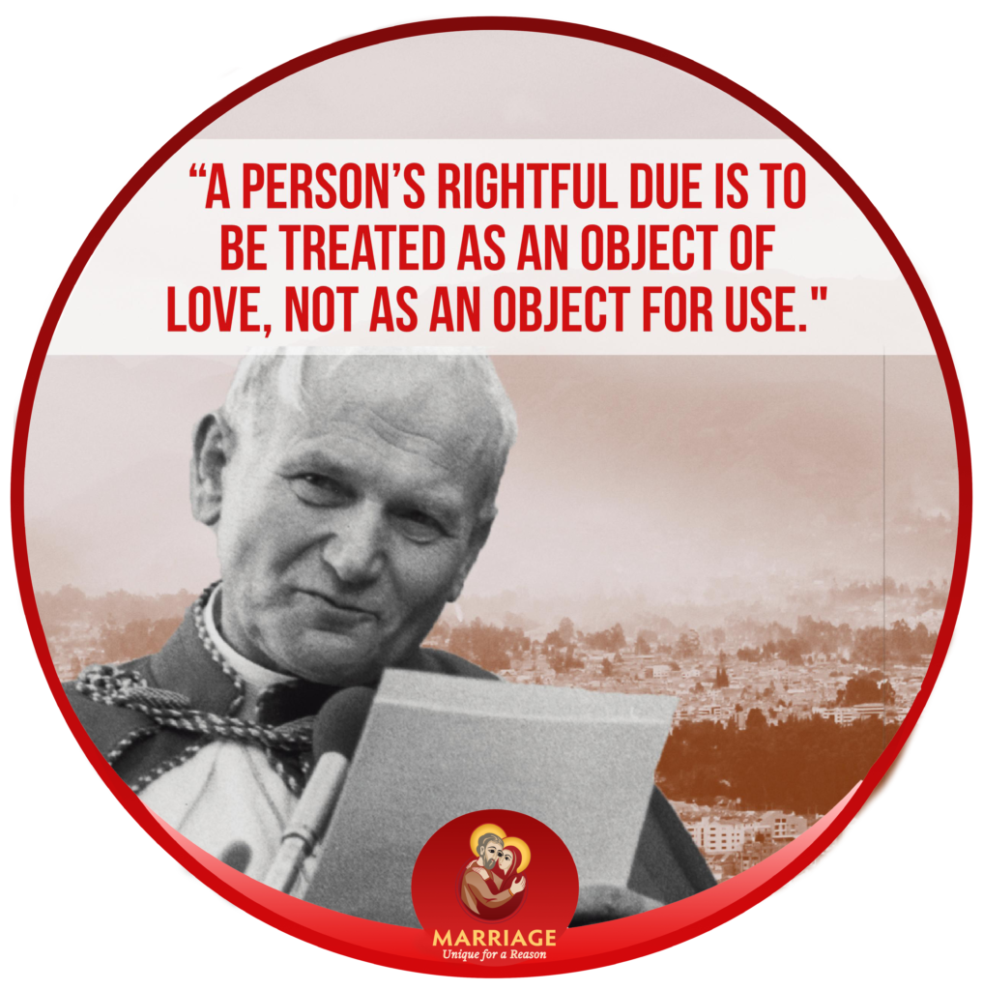
ENVISION: THEOLOGY OF THE BODY FOR MIDDLE SCHOOL
Seventh Grade Curriculum 6.1
What is Love? Love vs. Use

Slide 2
Bellwork
Think about the people who you know you are married: your parents, your aunts and uncles, your grandparents, your neighbors, etc.
Answer the following questions regarding one couple which has a great marriage:
  How do you know they truly love each other? (3 supporting details please)
  How do they sacrifice for each other (3 supporting details please)?
  What do you admire most about their marriage or their family?

Slide 3
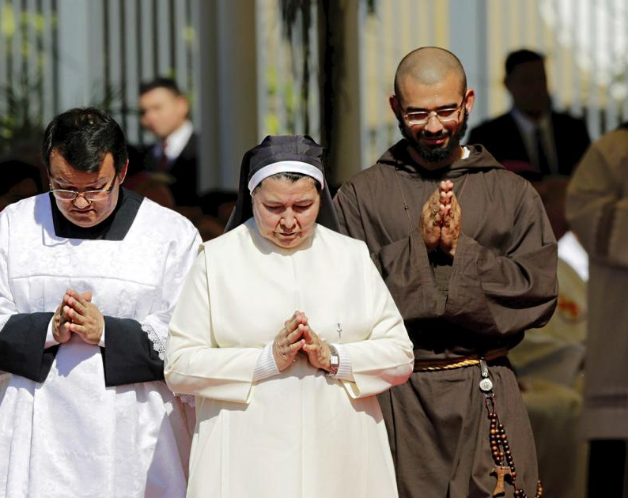
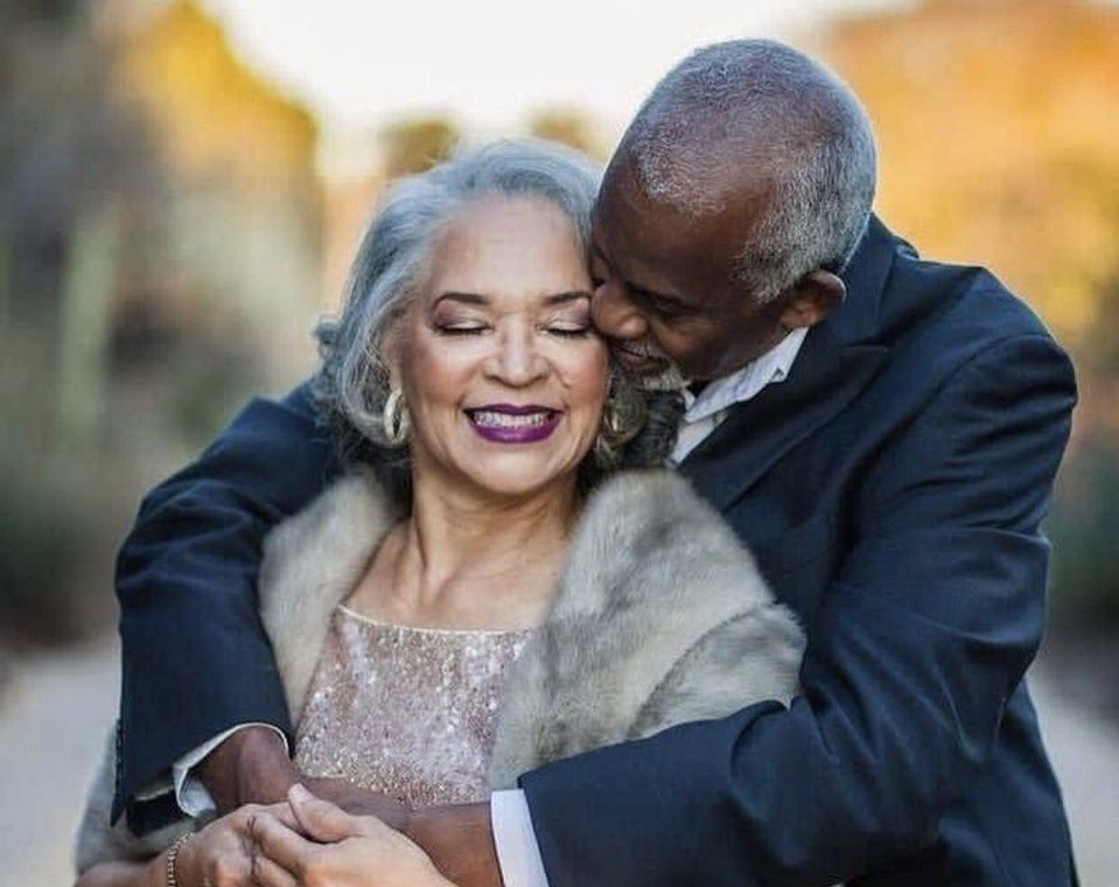
Opening Prayer
In the divine image, Lord, you created him; male and female you created them. God our Father, you made us male and female, created in your image and likeness. Help us grow into the men and women that you created us to be. Show us the goodness of our bodies and the right way to honor the brothers and sisters around us as a constant reminder of their dignity.
Jesus, you taught us to address your Father as you did, and so, in the Holy Spirit, we pray, Our Father…

Slide 4
Unpack the Quote
“A person’s rightful due is to be treated as an object of love, not as an object for use.”
—St. John Paul II, Love and Responsibility

Slide 5
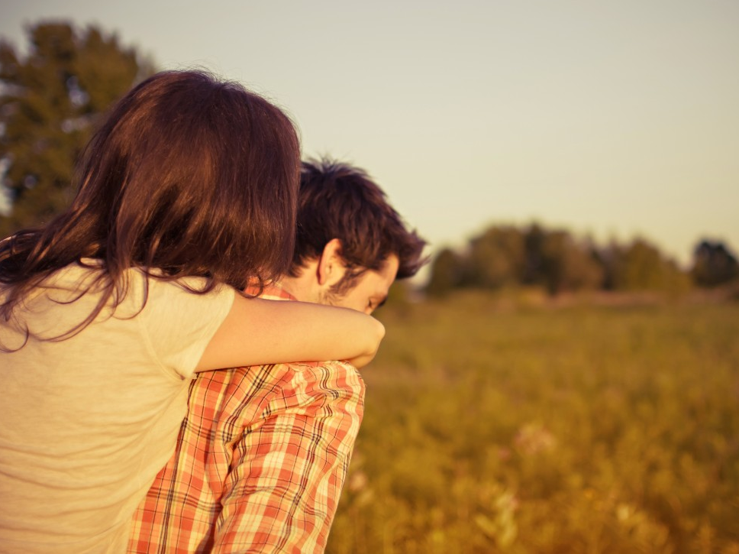
Story Starter, pg. 82-83

Slide 6

IF YOU ASK ME…
When I think about love, ______ is a song that comes to mind.
I think _____ (movie, book, or show) is a good love story.
_____ is someone in my life who shows me what real love is.
My definition of love so far is _____.

Slide 7
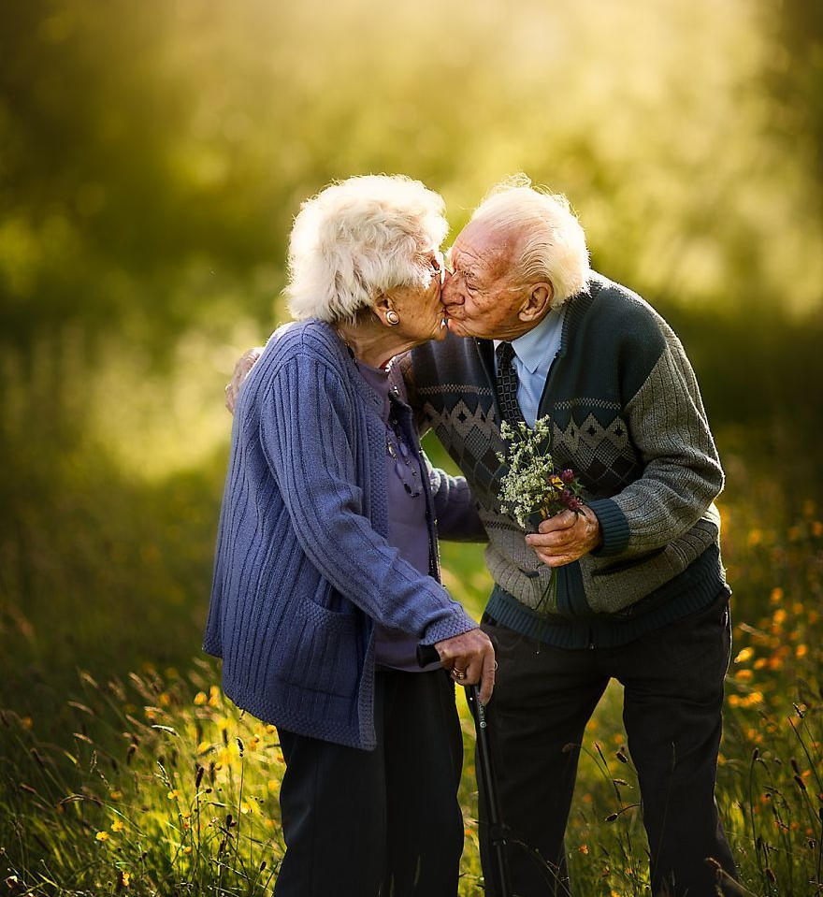

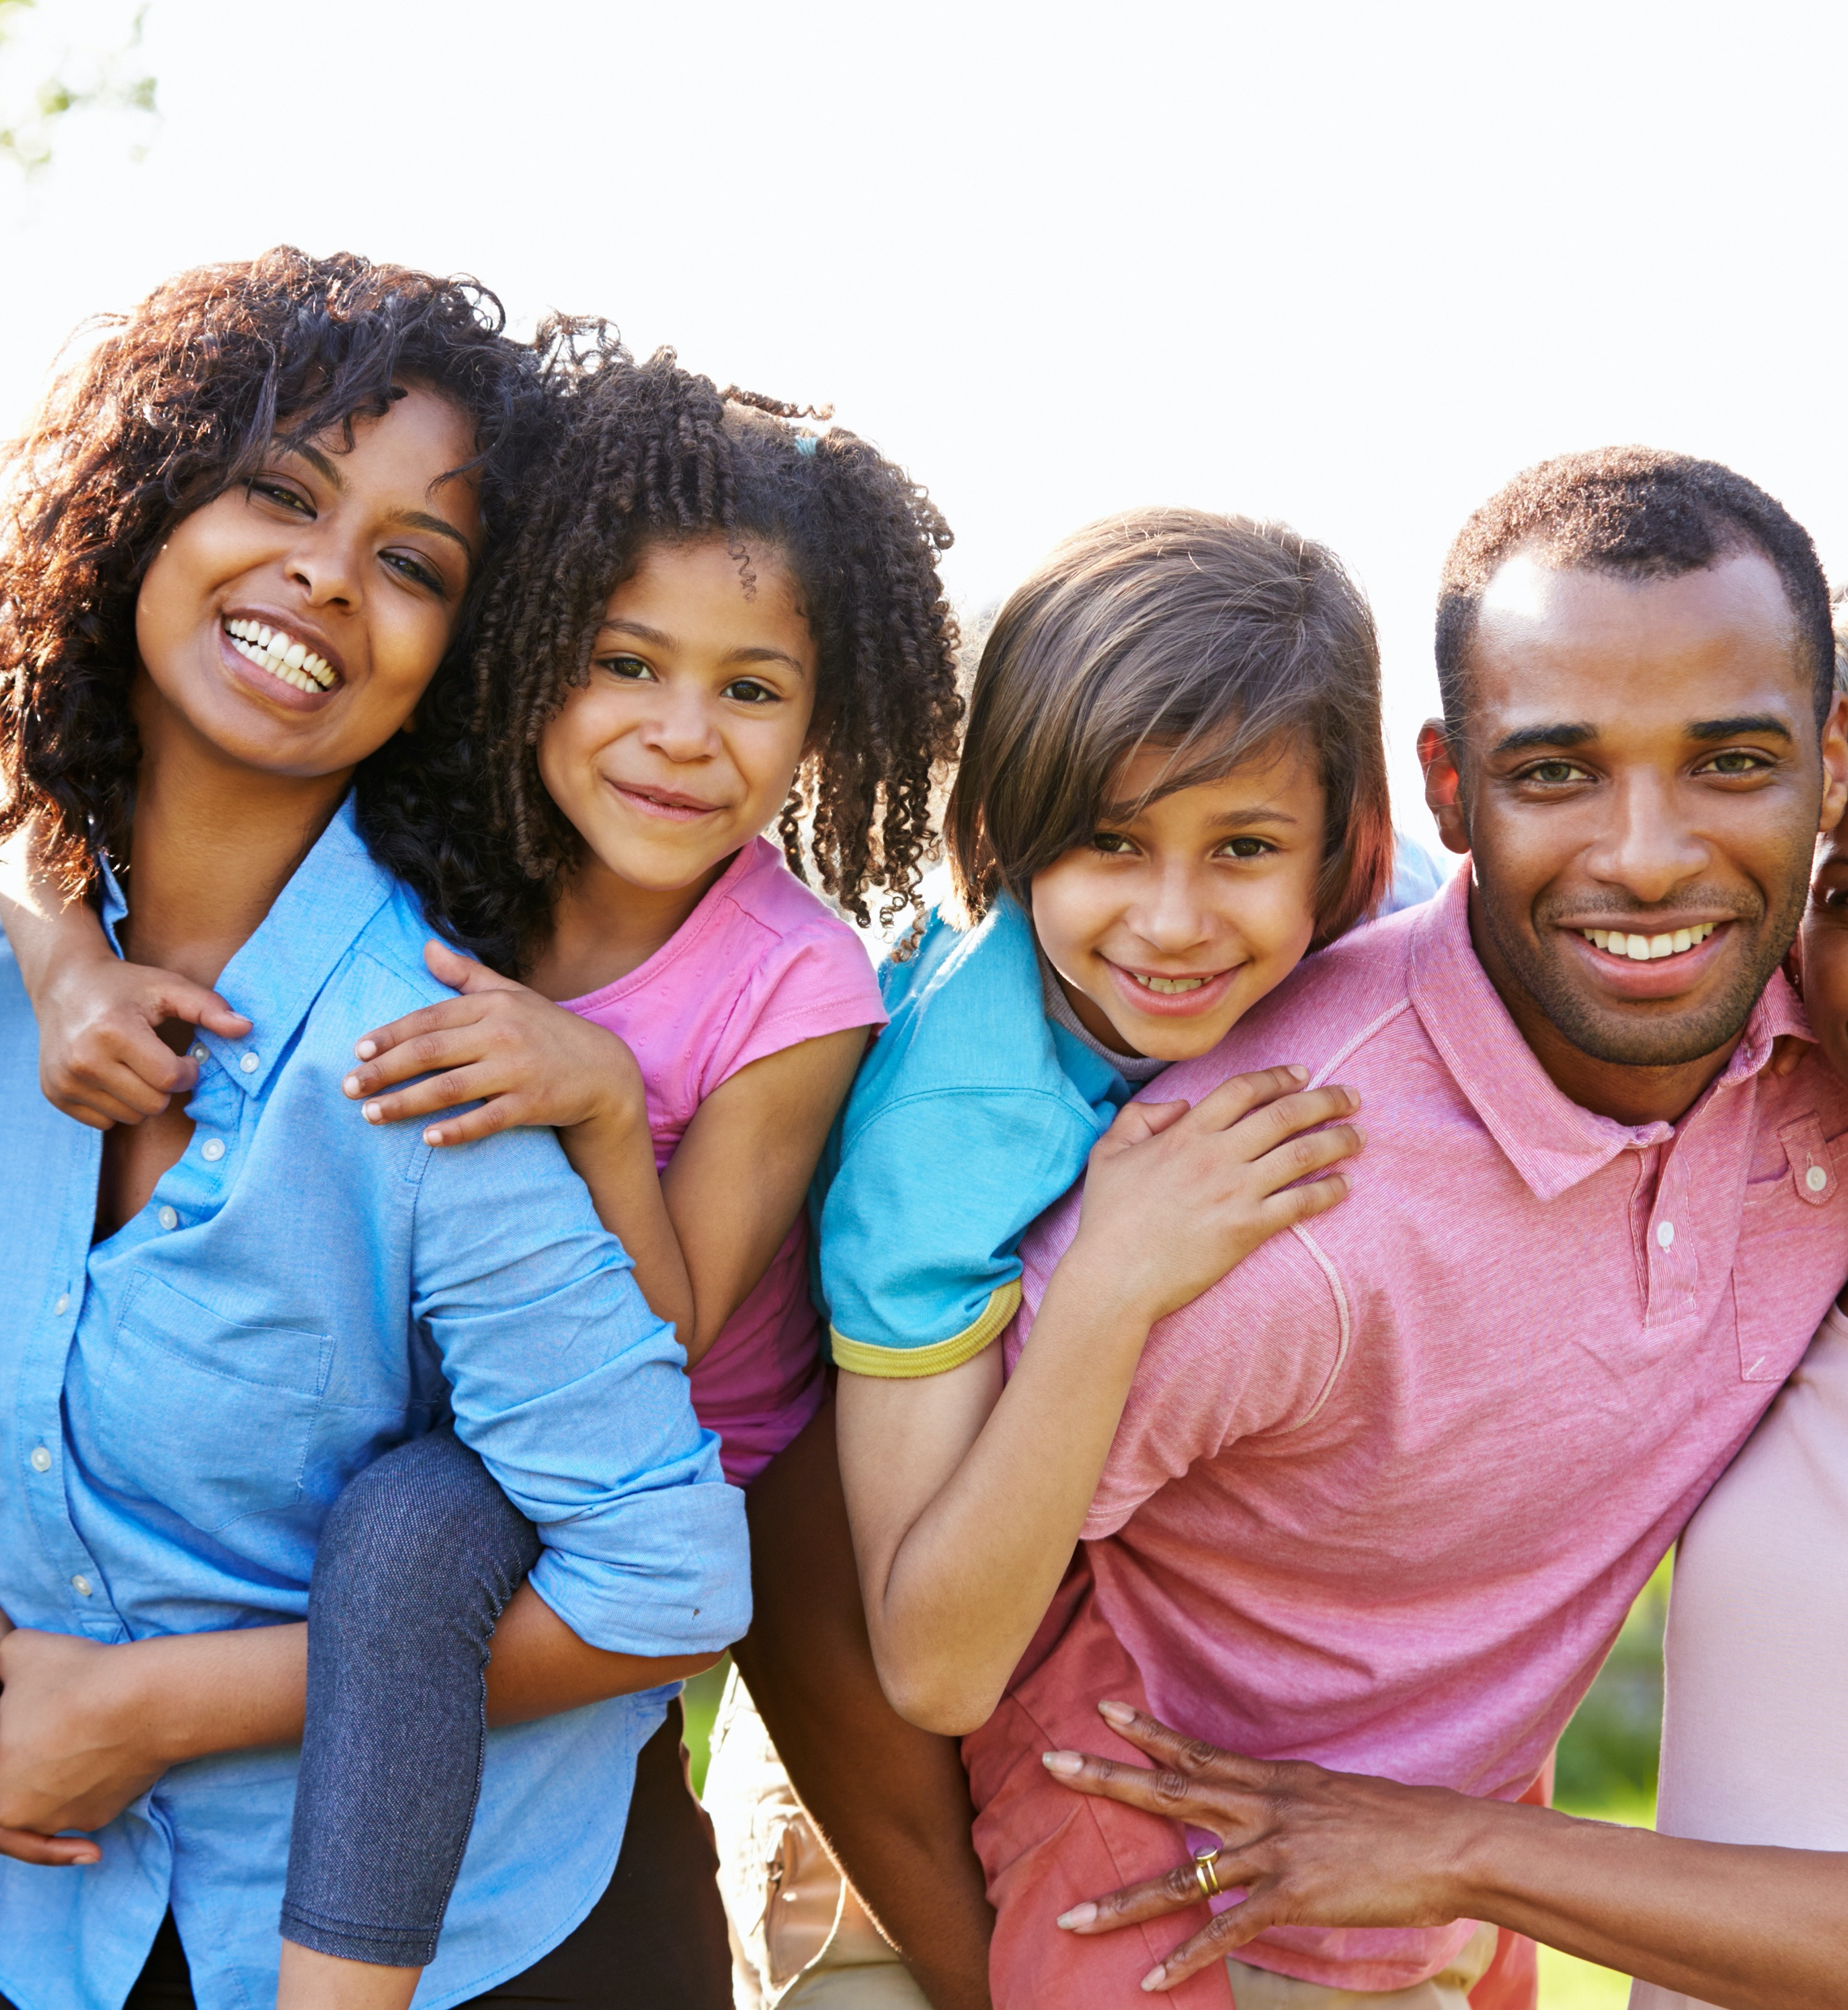
Video 1: Introduction
IF YOU ASK ME...
What do you think love is?

Slide 8

Video 2: To the core
True or false?
Love goes much deeper than feelings.
Jim’s gift to Aimee was important because it was expensive.
The opposite of love is use.

Slide 9

What is love?
How are love and use total opposites?
God made things to be used and people to be loved, but often we get it backwards.
We need to know what love looks like so our relationships can become a real participation in God’s love.
Notes:
Pgs. 84/85

Slide 10
IF YOU ASK ME...
A food I “love” is _____ because __________.
A person I love is _____ because __________.
I feel used when __________.
When I think of an example of a good relationship, I think of __________.

Slide 11

Eros + agape
We talked about these 2 types of love back in chapter 1.
Notes:
Catechists/DREs: depending on your timeline, you may not have used supplemental lesson 1 with your students. If this is the case, you can ask if any of the students know what eros and agape are, or omit this slide.

Slide 12
Eros + agape
Read together pgs. 85-6.
How would you summarize the relationship between eros and agape? Why does eros need agape?
Notes:
Catechists/DREs: depending on your timeline, you may not have used supplemental lesson 1 with your students. If this is the case, you can ask if any of the students know what eros and agape are, or omit this slide.

Slide 13

IF YOU ASK ME...
Listen to a popular love song and determine what kind of love it describes.
Song: __________
Artist: __________
Number of times the lyrics say “I”/”me”:
Number of times the lyrics say “you”:
Number of times the lyrics say “we”:

