Slide 1
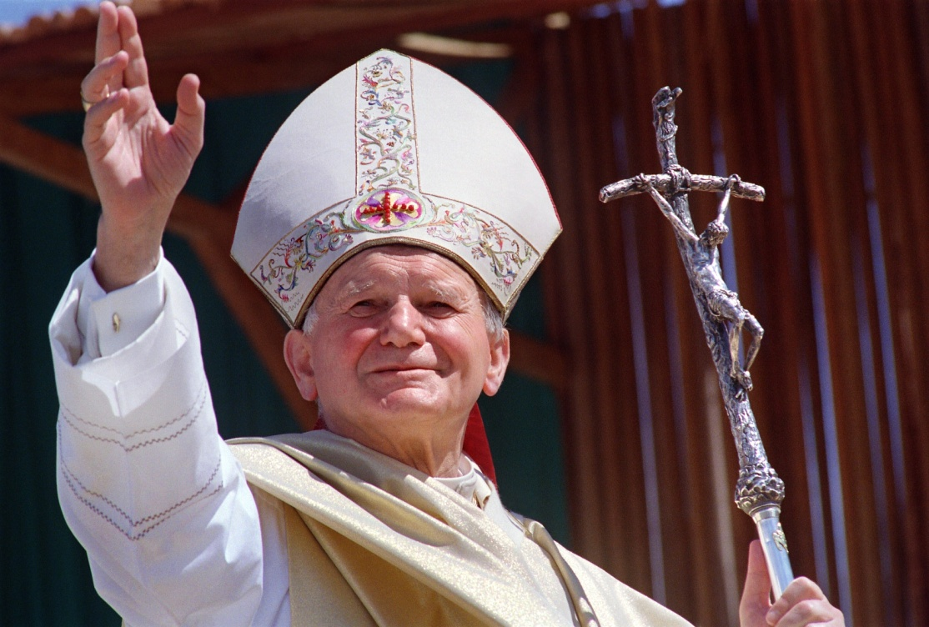
ENVISION: THEOLOGY OF THE BODY FOR MIDDLE SCHOOL
Seventh Grade Curriculum 7.1
Vocation to Holiness: God’s Call, My Response

Slide 2
Bellwork
Think about Ephesians 4:7-12
  “But grace was given to each of us according to the measure of Christ’s gift…He gave some as apostles, others as prophets, others as evangelists, others as pastors and teachers, to equip the holy ones…for building up the body of Christ…”
Answer :
  What 3 gifts has God given you that you can use to encourage others in their identity as children of God?
  How do you see yourself “building up the body of Christ” in high school?

Slide 3
Opening Prayer
In the divine image, Lord, you created him; male and female you created them.
You made each of us unique and unrepeatable so we can shine light in a dark world. Give us the grace to listen to your voice. Set our hearts on fire for the great adventure of saying yes to you and yes to holiness.
Jesus, your heart burned with love and beat in perfect obedience to the Father, and so, in the Holy Spirit, we pray for the same love and fidelity, Our Father ... Amen.

Slide 4
Unpack the quote
“In the hidden recesses of the human heart the grace of a vocation takes the form of a dialogue. It is a dialogue between Christ and an individual, in which a personal invitation is given. Christ calls the person by name and says: ‘Come, follow me.’ This call, this mysterious inner voice of Christ, is heard most clearly in silence and prayer. Its acceptance is an act of faith.”
—St. John Paul II, Homily, India, 1986

Slide 5
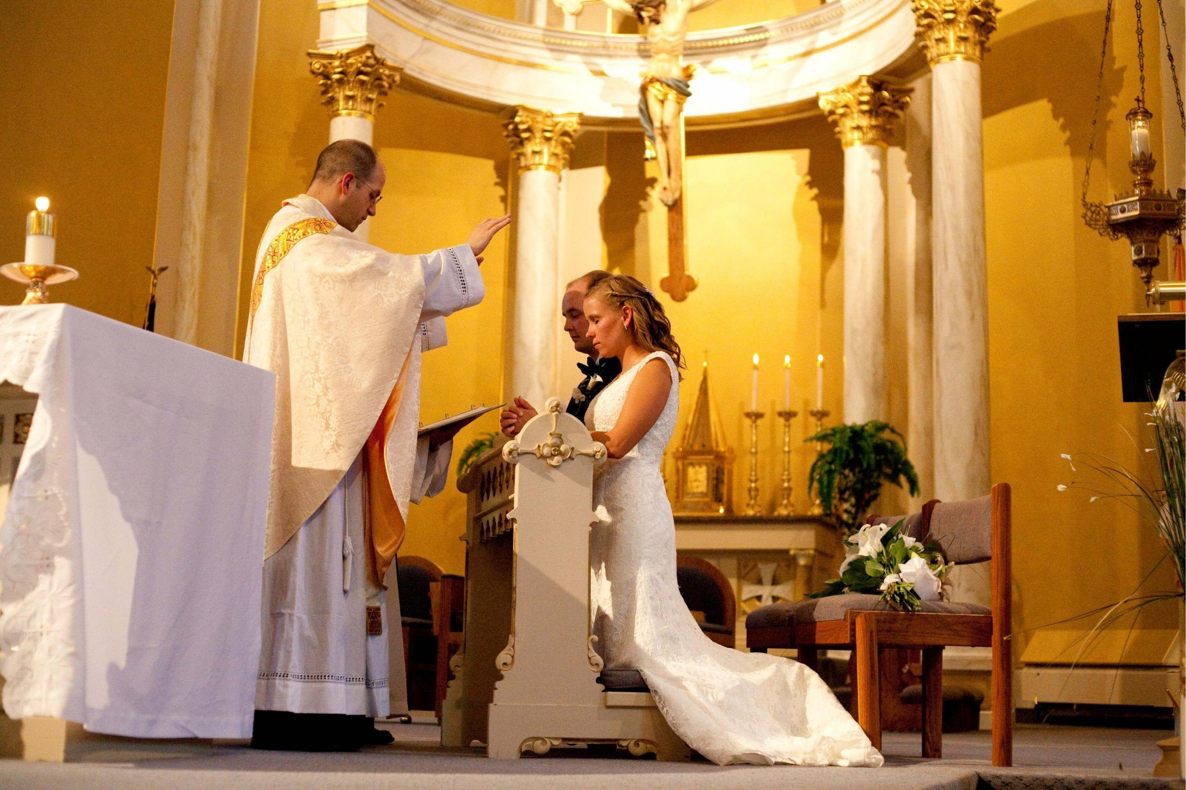
Story Starter, pg. 100

Slide 6
IF YOU ASK ME…
What do you think is the best sign of holiness?
Kindness
Joyfulness
Honesty
Obedience
Humility
Chastity
Piety
I think that (single life, married life, religious life, ordained life) is the holiest because ____________________.
A girl around my age who is holy is ________ because she ________________.
.• A boy around my age who is holy is _______ because he __________.

Slide 7

Video 1: Introduction
What do you think the voice of God sounds like? How do you listen for God’s voice?

Slide 8
Video 2: To the Core
True or False:
Everyone is called to holiness
Being holy means being perfect.
Future relationships don’t need to look like the brokenness we see or may have come from.

Slide 9
Group Activity
  Read “Vocation to holiness” on pg. 102 and “Saint You” on pg. 103: How does individuality play into vocation?
  Something that helps people grow in holiness is ___________.
  Something that prevents people from growing in holiness is ___________.
Every call from God is a call to holiness. This is a vocation.

Slide 10

Many paths to holiness: marriage
  Read “Called to marriage” on p. 104-5: How does the Church understand marriage?
  The longest I have heard of a couple being married is _____ years.
  A couple who is a good example of married life is _______ and _______.

Slide 11
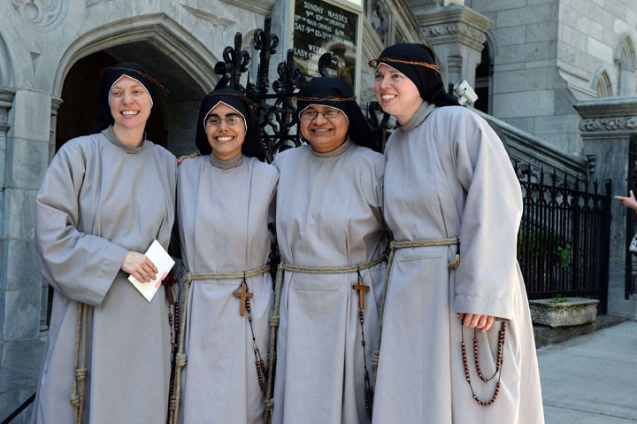
Many paths to holiness: consecrated life
  Read “Called to consecrated life” on p. 105-6: What is this vocation like?
  One valuable thing that consecrated people have more time for is _______.
  I think the best thing about religious life would be _______.

Slide 12
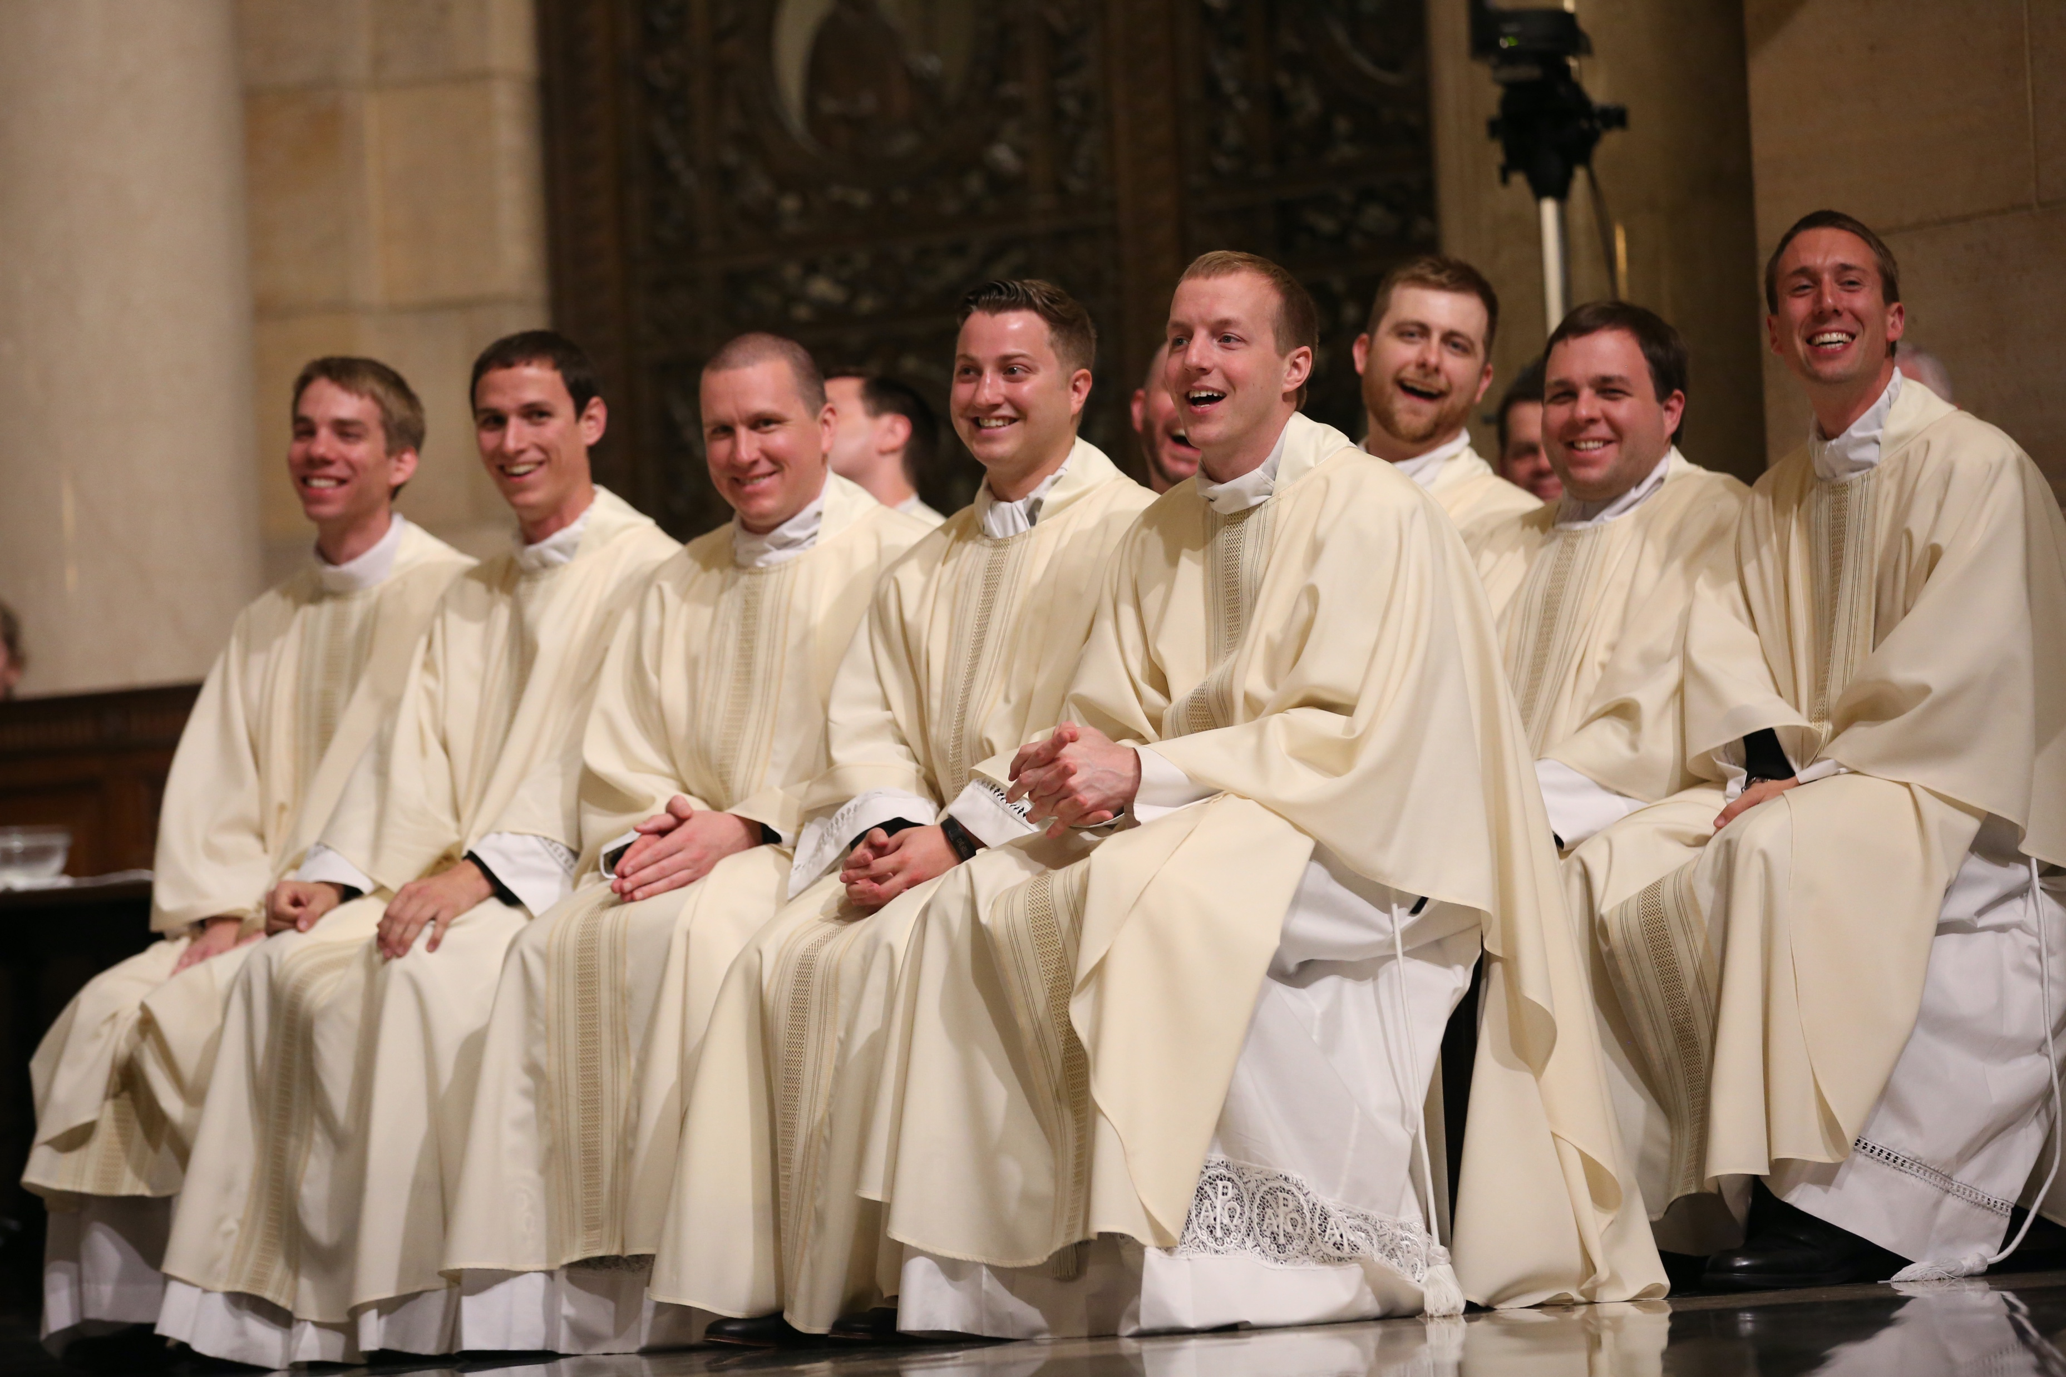
Many paths to holiness: ordained life
  Read “Called to ordained life” on p. 106: Why are priests called “Father”?
  A priest who is a good example of the priesthood is _______.
  Something I am really thankful that priests do is _______.

