Slide 1
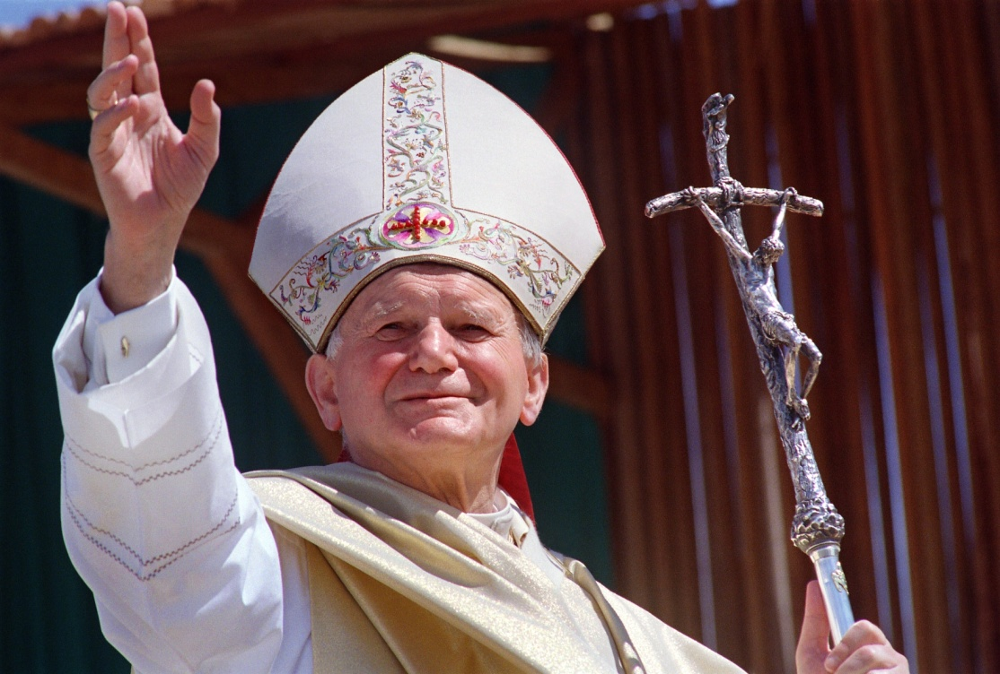
ENVISION: THEOLOGY OF THE BODY FOR MIDDLE SCHOOL
Seventh Grade Curriculum 7.2
Vocation to Holiness: God’s Call, My Response

Slide 2
Bellwork
Write three answers for each question please.
  Three things that distract me from seeing Jesus’ face and hearing God’s voice are:
    1.
    2.
    3.
  Three things I could do in order to see Jesus more clearly in my daily life and to listen more closely to God’s voice are:
    1.
    2.
    3.

Slide 3

Opening Prayer
My Lord and my God, take from me everything that distances me from you.
My Lord and my God, give me everything that brings me closer to you.
My Lord and my God, detach me from myself to give my all to you. Amen.
(Saint Nicholaus of Flue)

Slide 4
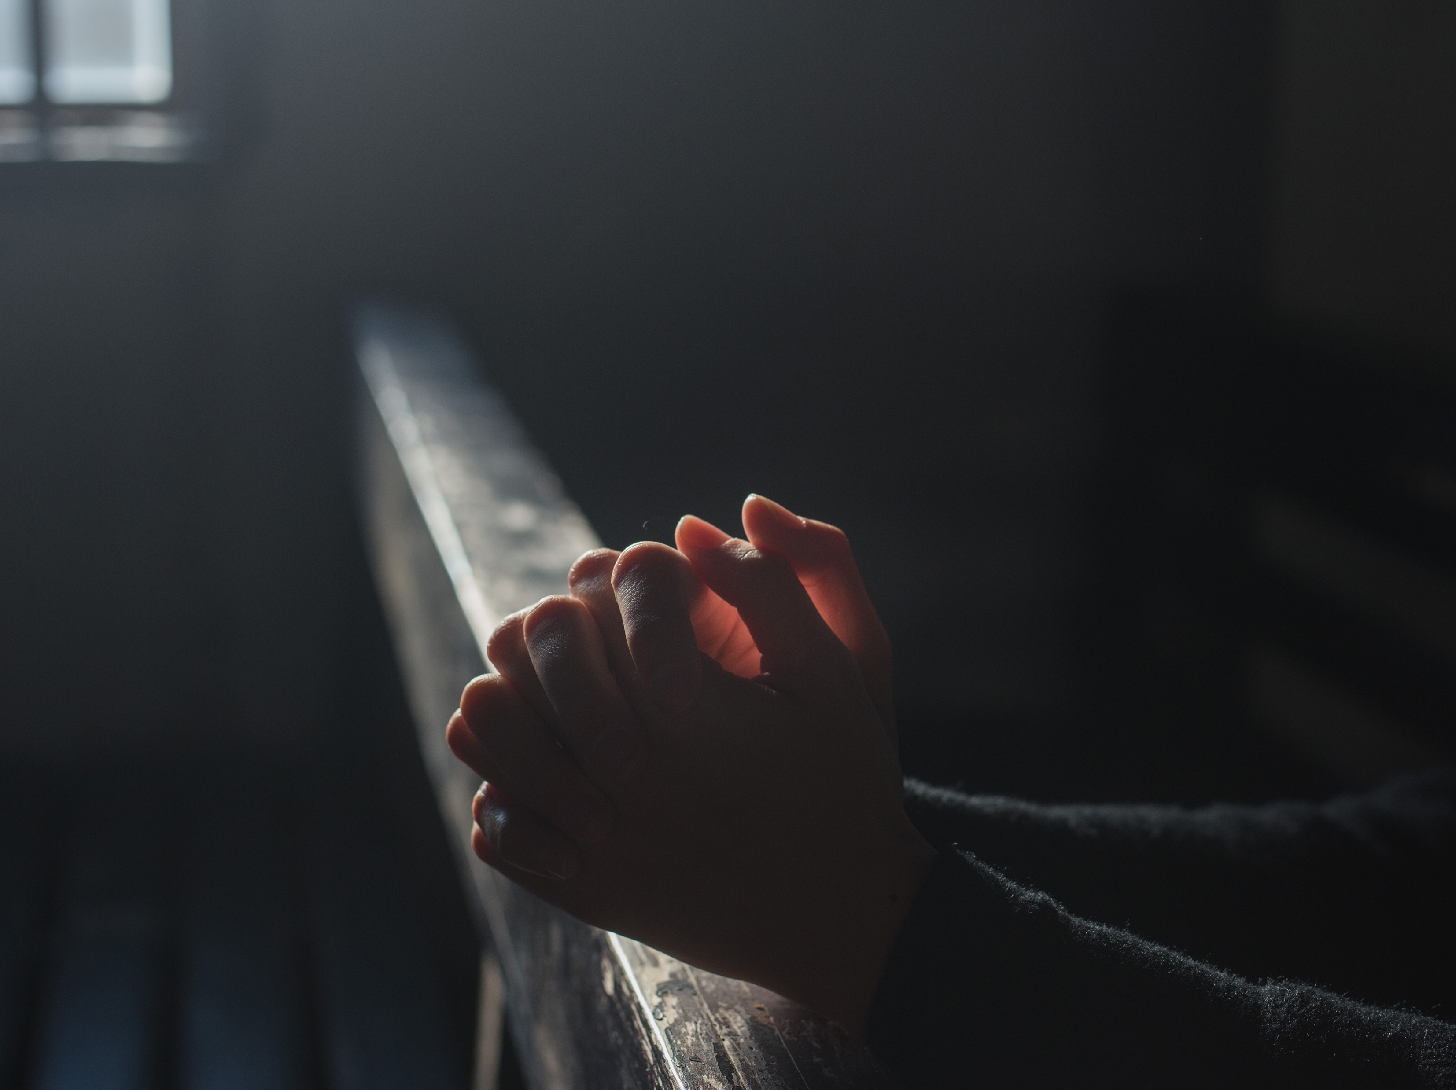
Discernment
Is God calling you? The answer is yes!
Discernment is the process of discovering your vocation. The most important parts of discernment are asking God what he wants and listening to his response through regular prayer.
God will not call you to a vocation that makes you miserable; His plan for your life will bring you more joy and peace than anything you could dream up yourself.
God usually calls us to a particular vocation gradually. Right now, your job is simple: focus on learning to trust and listen to God.

Slide 5
The 5 L’s of Discernment
The five Ls—look, listen, learn, live, and love—are practical steps to help you discern.

Slide 6
Look
Look for Jesus in your ordinary life. Maybe you will see Jesus in someone who needs your help. Maybe you will see Jesus in volunteer work.
When you are discerning your vocation, remember: the places where you find Jesus are the places you are called to be. Look for Jesus in your daily life and—when you see him—follow.

Slide 7
Listen
Listen to God’s voice. Life is filled with distractions and noise. We can’t listen to God if we can’t hear him – so we need to take time for silence and prayer.
How do you pray and listen? Here are three important ways:
  Read the Bible.
  Go to Eucharistic Adoration. Instead of talking or thinking, just listen quietly.
  Listen for Jesus speaking through others.

Slide 8
Learn
Learn your purpose by exploring your gifts and desires.
To get a feel for how you would fit into different vocations, spend time exploring each one. Pay attention to married couples and parents. Visit a convent, monastery, or seminary. Talk to someone in consecrated single life.

Slide 9
Live
Live to the maximum, not the minimum. What are some specific ways you can do this?
Be virtuous, different, and bold. True Christian life is not boring, but an adventure.

Slide 10
Love
Love like God. This one is the most important. If you want to know your vocation, you need to practice loving like God loves. The more we love others, the more we become our true selves.
If you learn to love like God in your daily life, then discerning your vocation will become an exciting adventure, not a stressful unknown.

Slide 11
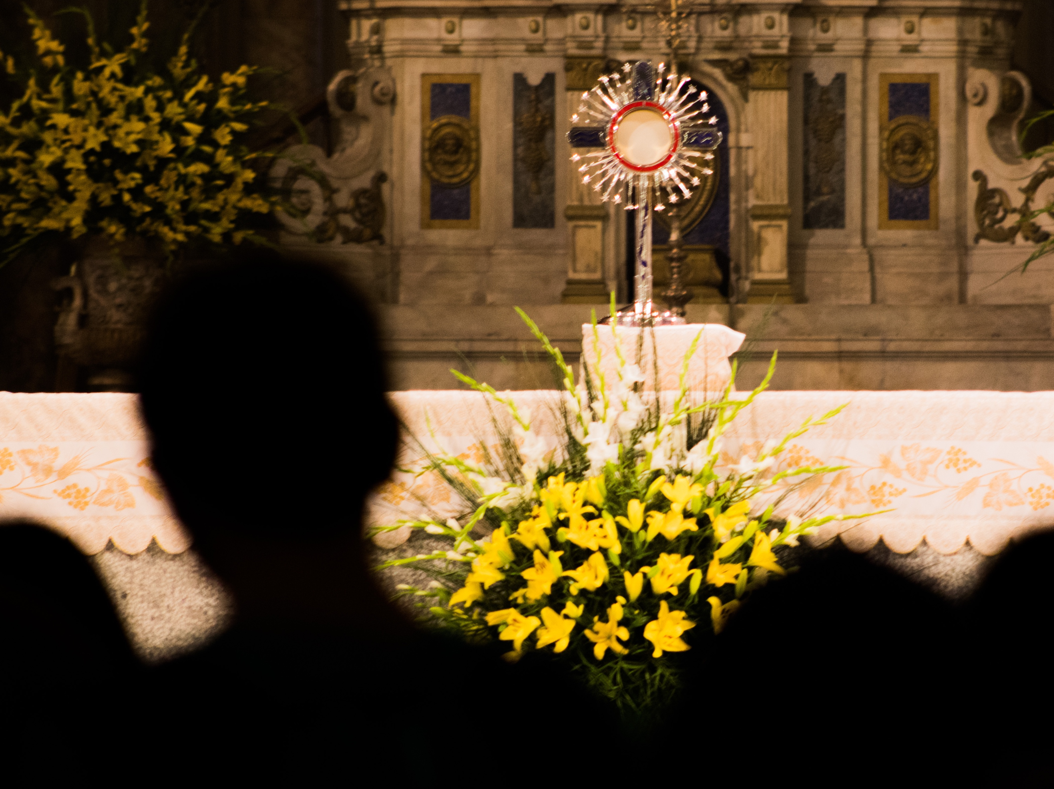
IF YOU ASK ME…
One place I find Jesus in my life is _______.
Someone who lives to the maximum is _______.

Slide 12
What about now?
Start by committing to five minutes of prayer each morning.
→A specific time every morning I can pray is __________.
Spend quality time with your friends and family instead of isolating yourself on devices and screens.
→A specific activity I can do with my family or friends is _________.
Each evening, review how well you lived out the five Ls.
→A specific time every evening I can review my day is __________.
Clear the noise. If we live with constant distractions, it is much harder to recognize and follow God’s voice.
→A specific way I can clear some noise from my life is __________.

Slide 13
What about now?
Practice being kind, considerate, attentive, forgiving, and helpful.
Don’t rush into dating.
The purpose of dating is to find a spouse. Are you ready to discern marriage?
Instead of dealing with the pressure of serious dating, find peace and fun by spending time with friends.
Choose chastity internally and externally.
Stay focused on virtue in all your relationships.

Slide 14
If you ask me…
I think the ‘L’ I need to work on the most is __________.

Slide 15

Video 3: Witness + Wrap-up

Slide 16
Got It?
LOOK for Jesus.
LISTEN to God’s voice.
LEARN your purpose.
LIVE to the maximum.
LOVE like God.

Slide 17
Closing prayer
In the divine image, Lord, you created him; male and female you created them.
God our Father, you call each of us by name to be close to you and to be fully alive. Thank you for the people in our lives who teach us to faithfully follow your call. Help us eagerly listen and respond to your call, trusting that your plans are always best for us.
Jesus, your Mother Mary followed God’s will in all things, so we turn to her now as we pray, Hail Mary ... Amen.

Slide 18

Vocabulary
Vocation
Marriage
Consecrated life
Religious orders
Holy orders
Discernment

