Slide 1
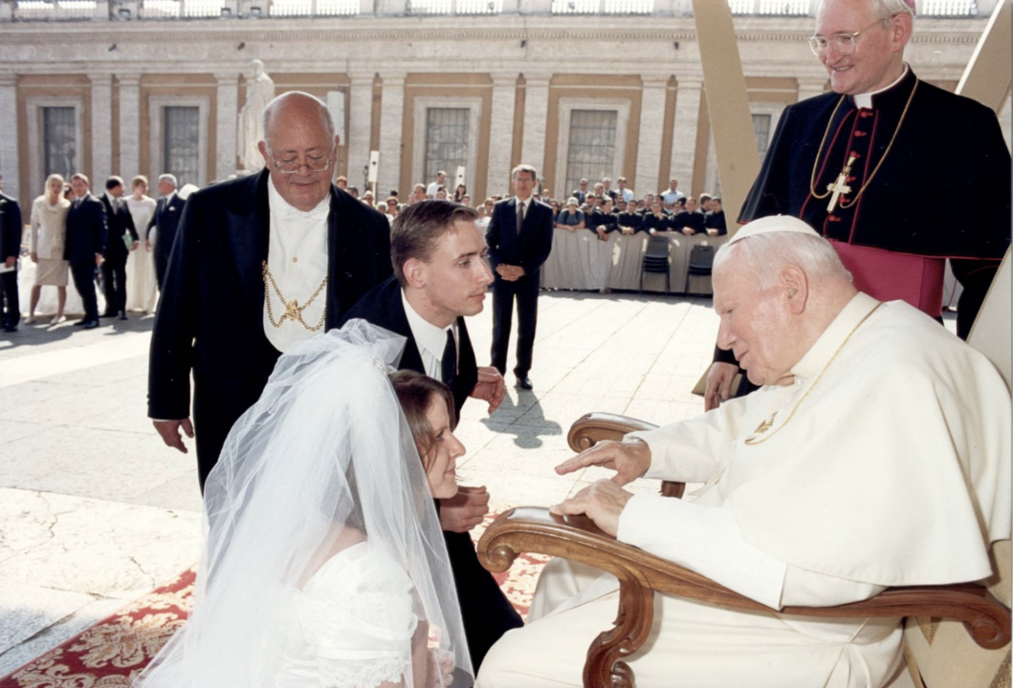
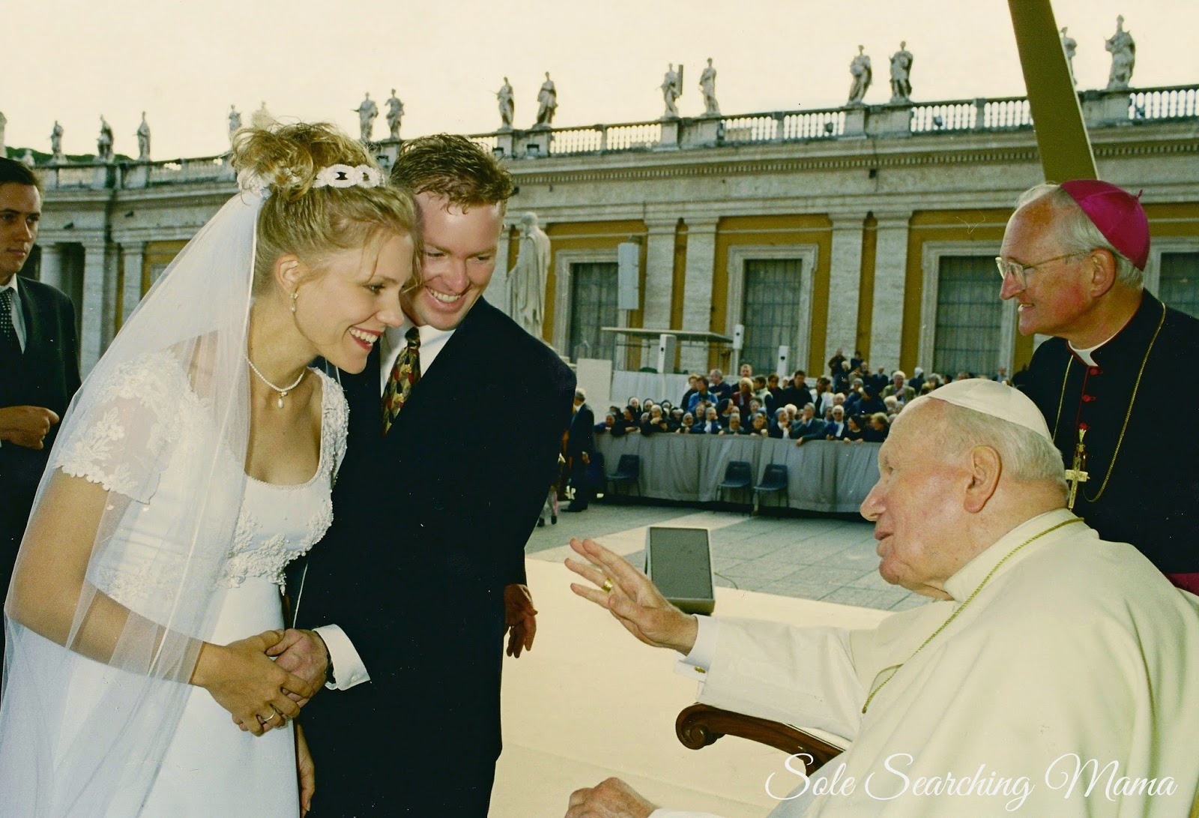
ENVISION: THEOLOGY OF THE BODY FOR MIDDLE SCHOOL
Seventh Grade Curriculum 7.3
Married Love: Free, Total, Faithful, Fruitful

Slide 2
Bellwork
Think about this quote from Saint John Paul II:
“Man cannot live without love. He remains a being that is incomprehensible for himself, his life is senseless, if love is not revealed to him, if he does not encounter love, if he does not experience love and make it his own, if he does not participate intimately in it.” (Redemptor Hominis 10)
Answer the following questions with your opinions and insights:
  Who reveals love to you most consistently?
  How do you give of yourself to this person(s) in return?

Slide 3
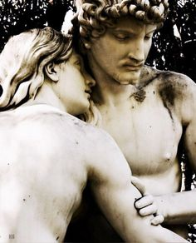
OPENING PRAYER
Imago Dei Prayer
Heavenly Father,
in your great love,
you have made us
in the image of your Son.
Grant that we may reverence our bodies
as living temples of the Holy Spirit
and so cherish the gift of sexuality,
our masculinity and femininity,
our power to procreate
and nurture life,
that we make visible
the total self-giving love
of the divine Persons
in the Trinity.
Amen.

Slide 4


Watch:
What is Marriage?
"An intimate community of life and love willed by God in which a man and a woman make a complete gift of themselves to each other for the rest of their lives."
Play the following clip from Chosen:
https://www.youtube.com/watch?v=47LaozR2NCs

Slide 5

How does God see marriage?
Storge + Philia + Eros + Agape:
Familial Unity +
Friendship + Attraction/desire + self-giving/sacrifice
Unity of the four kinds of love with which God loves humanity: an indissoluble union

Slide 6
Sex is the Body Language of Married Love
Sexual intercourse is intended by God to be the most intimate sign of the mutual gift of self which a man and woman make to one another in.
  In sexual union, a husband and wife say with their bodies in a private way what they said publicly at the altar on their wedding day: “I accept you completely as the gift that God created you to be, and I give myself to you completely in return.”
This mutual gift of self is not meant to remain closed in on itself, but rather, makes the spouses capable of becoming cooperators with God in giving life to a new human person.

Slide 7
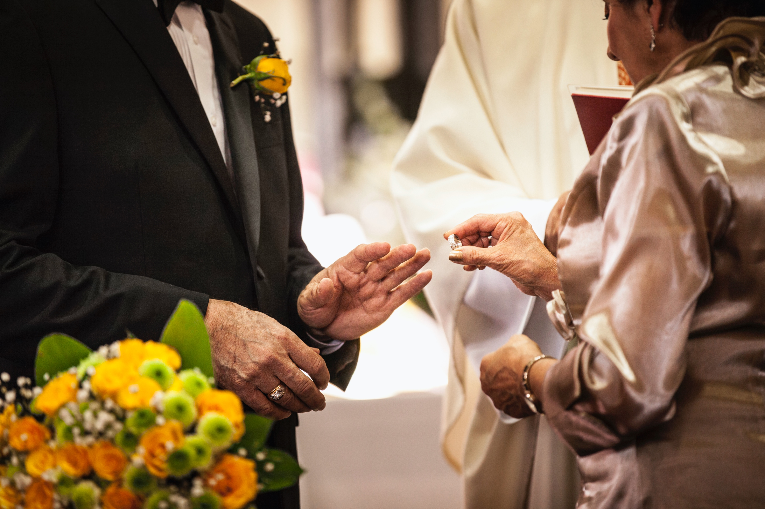
What do the questions put to bride and groom reveal?
With a seatmate, decide what each question reveals about marriage:
Have you come here to enter into Marriage without coercion, freely and wholeheartedly?
Are you prepared, as you follow the path of Marriage, to love and honor each other for as long as you both shall live?
Are you prepared to accept children lovingly from God and to bring them up according to the law of Christ and His Church?

Slide 8

The Gift of Self Must Be Free
The gift of self in marriage must be free
  Not coerced
  Not forced
  No conditions enforced for loving

Slide 9

The Gift of Self Must Be Total
The gift of self must be total and without reservation
  Not only a partial gift
  Not accepting only some aspects of the other
  Sexual relations are the sign of this gift
    “In marriage the physical intimacy of the spouses becomes a sign and pledge of spiritual communion” (CCC 2360)
Contraceptives contradict this meaning
  Suppresses life-giving potential
  Withholds gift of fertility from one’s spouse

Slide 10
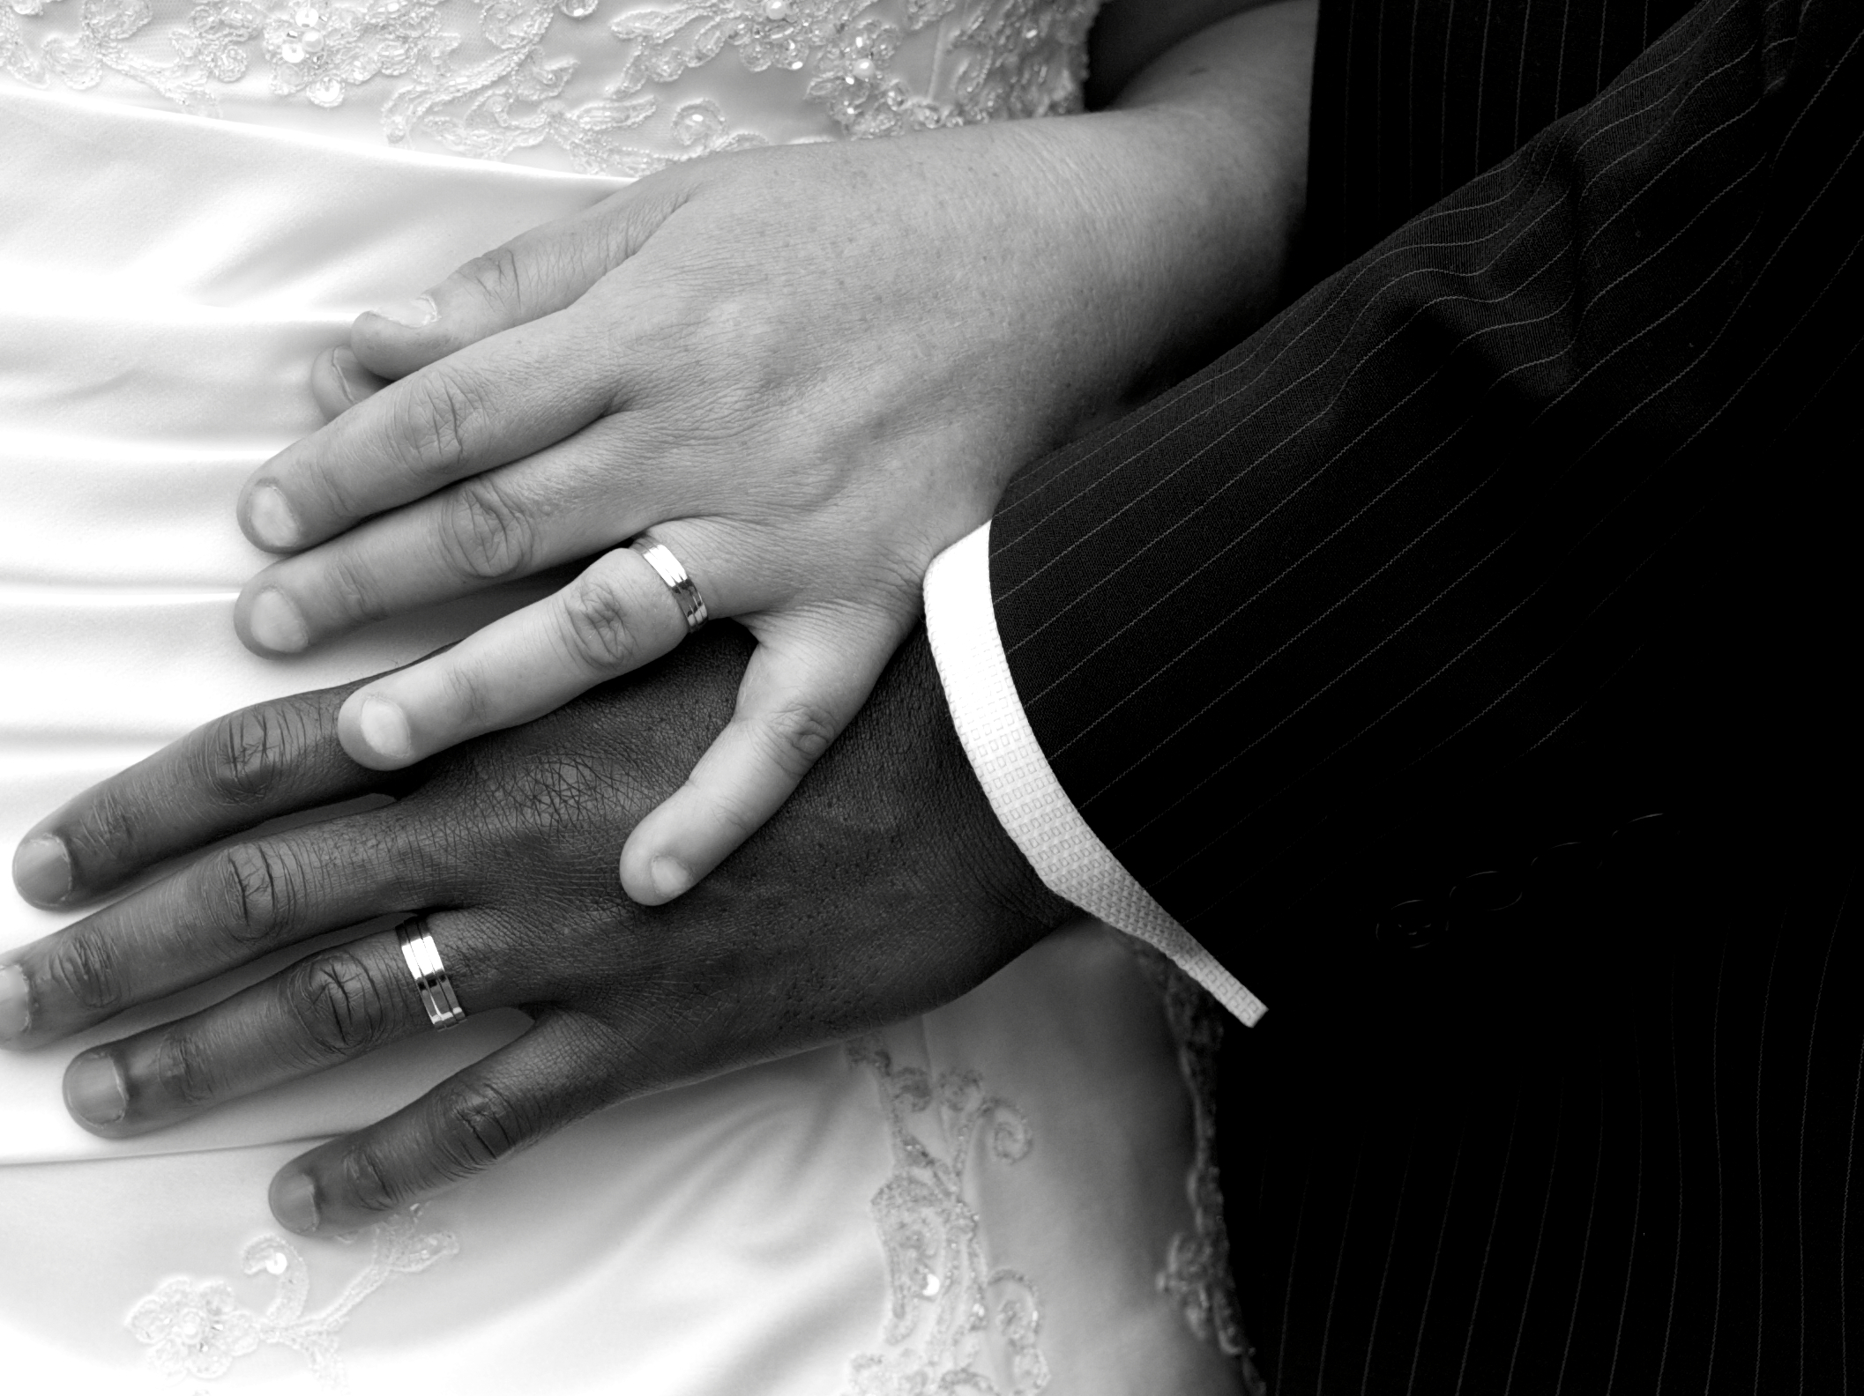
The Gift of Self Must Be Faithful
The gift of self must remain faithful and exclusive until death
  Marriage is indissoluble
  Like God never forsakes his people
  Like Christ never forsakes his Bride, the Church
  Helps children flourish
Sometimes a marriage is not valid from its beginning because it lacks an essential element (annulment)

Slide 11
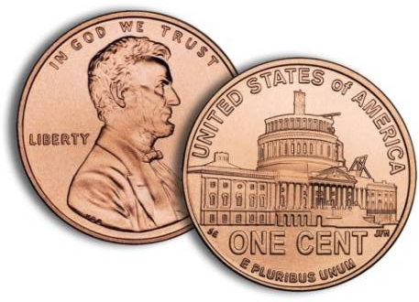
The Gift of Self Must Be Fruitful
The gift of self must be open to creating new life (children)
  Sexual intimacy is like a two-sided coin: it is love-giving and life-giving for the married couple
  Couples are called to practice abstinence if they prayerfully intend not to conceive (an effective means of postponing pregnancy)

Slide 12

VIDEO: LOVE & NEW LIFE
https://youtu.be/VcyOzym2UV8

Slide 13
What about couples who cannot have children?
When difficulties with infertility arise
  Opportunity to practice “spiritual parenthood”
  The Church can help determine which medically assisted procedures are morally acceptable
  Some couples are called to adopt children
When parents cannot raise the child they have conceived
  Adoption is the responsible and generous choice
Notes:
Re IVF: “Techniques that entail the dissociation of husband and wife, by the intrusion of a person other than the couple (donation of sperm or ovum, surrogate uterus), are gravely immoral. These techniques (heterologous) artificial insemination and fertilization) infringe the child’s right to be born of a father and mother known to him and bound to each other by marriage. They betray the spouses’ “right to become a father and a mother only through each other.” (CCC, #2376)”

