Slide 1
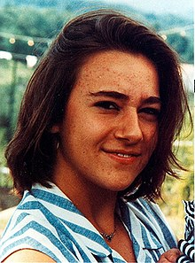
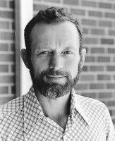
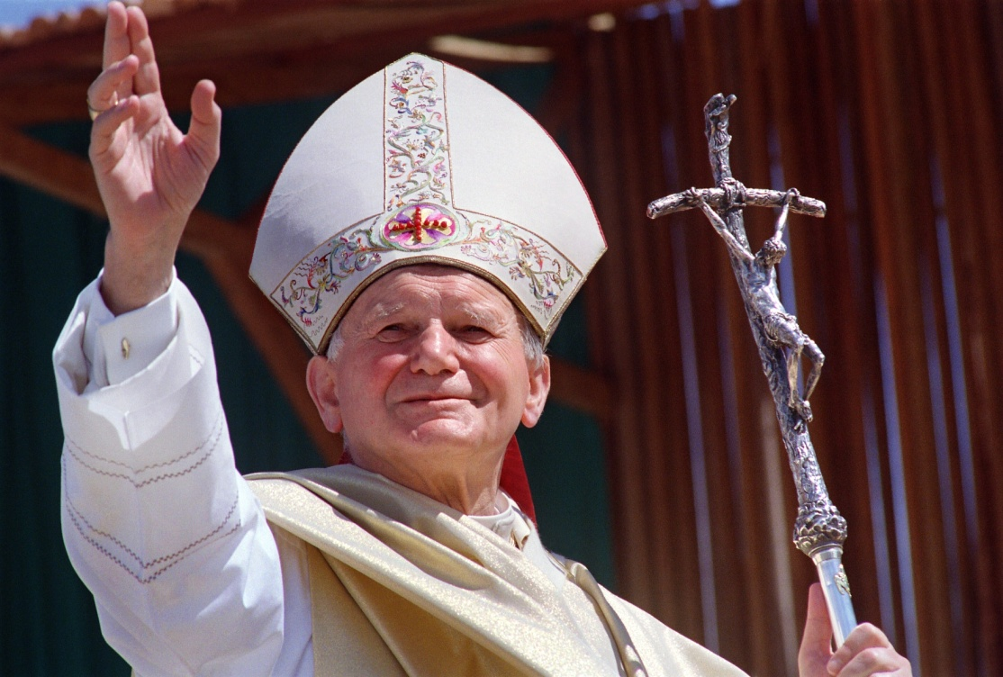
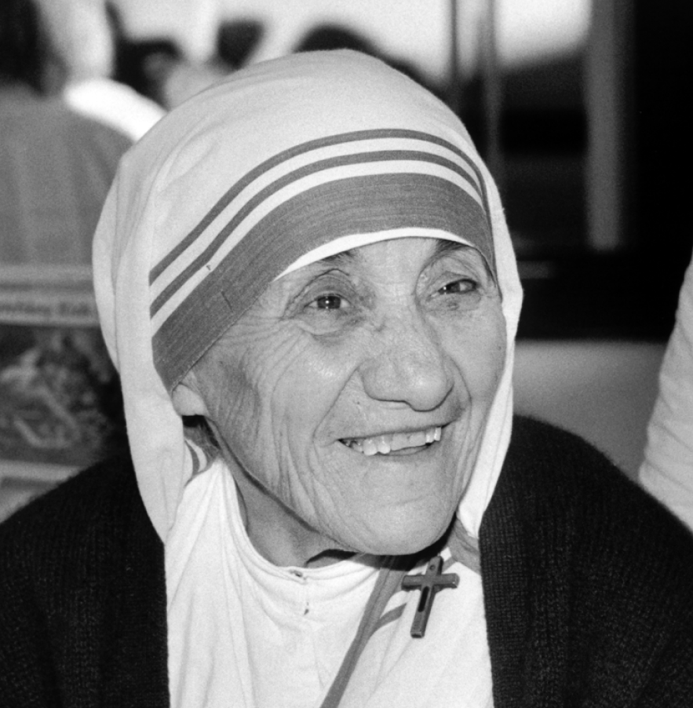
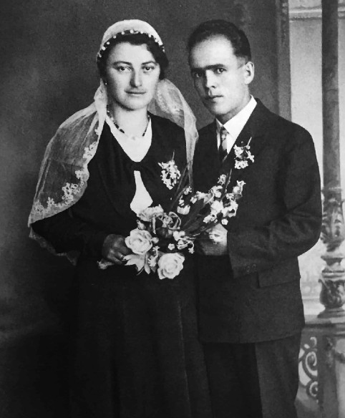
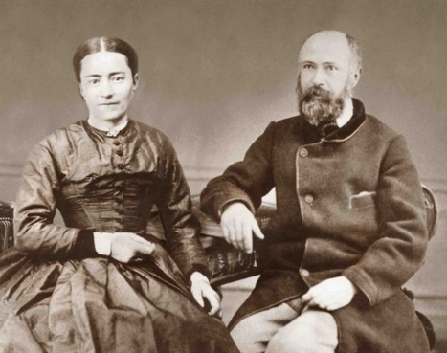
ENVISION: THEOLOGY OF THE BODY FOR TEENS
Seventh Grade Curriculum 4.3
The Saints: Heroic Witnesses
to Love
Notes:
Saints pictured: Bl. Chiara Luce Badano (top left), St. Mother Teresa (middle left), Bl. Franz Jagerstatter and his wife Franziska (bottom left); Bl. Stanley Rtoerh (top left), Sts. Louis and Zelie Martin, parents of St. Therese (bottom right)

Slide 2
Bellwork
Journal:
-Who in your life is a hero of love? What makes him/her an example for you? (Include at least 3 specific details.)
-Who among the saints inspires you with his/her love?

Slide 3
OPENING PRAYER:
Litany of the Saints
Lord, have mercy on us. Christ, have mercy on us.
Lord, have mercy on us.
Christ, hear us. Christ, graciously hear us.
God the Father of Heaven, Have mercy on us.
God the Son, Redeemer of the
World, Have mercy on us.
God the Holy Spirit, Have mercy on us.
Holy Trinity, One God, Have mercy on us.
Holy Mary, Pray for us.
Holy Mother of God, Pray for us.
Holy Virgin of Virgins, Pray for us.
[Add your role model or Confirmation
Saint name], pray for us.
Glory Be…
Amen.

Slide 4
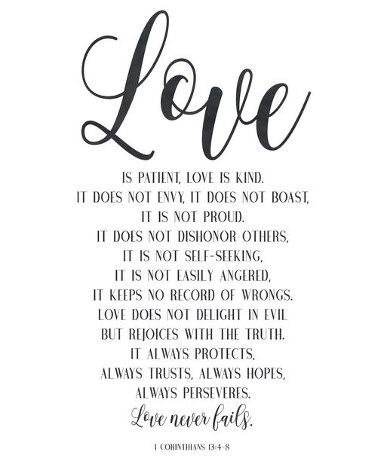
Bellwork Discussion
Who in your life is a hero of love?
Who among the saints inspires you with his/her love?

Slide 5
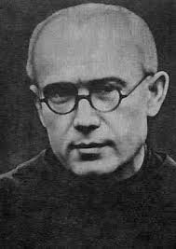
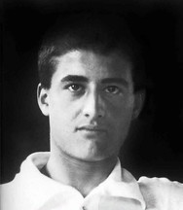
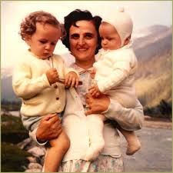
Saints Show Us Heroic Virtue
The saints, those holy men and women who have gone before us living lives of heroic love, are our examples to learn from and our intercessors in heaven.
“Only from the saints, only from God, does true revolution come, the definitive way to change the world.”
(Pope Emeritus Benedict XVI)
Notes:
Pictured: St. Maximilian Kolbe (top right), St. Gianna Molla (bottom right), Bl. Pier Giorgio Frassati (bottom left; will be canonized in August 2025)

Slide 6
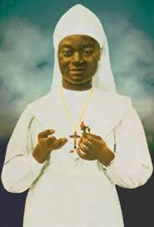
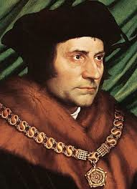
UNIVERSAL CALL TO HOLINESS
We are all called to love and to be holy within our personal vocations, whether we are called to marriage, ordained priesthood, consecrated single life, or religious life.
There have been many saints in each of these vocations; their diversity of lives and service show us how we can all live lives of chastity and holiness.
Notes:
Pictured: St. Thomas More (bottom left) and Bl. Marie-Clémentine (top right)

Slide 7
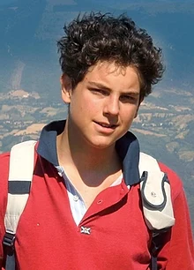
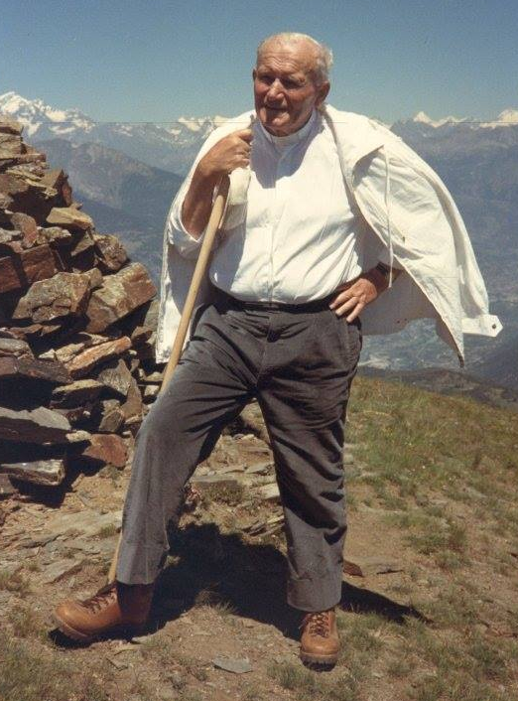
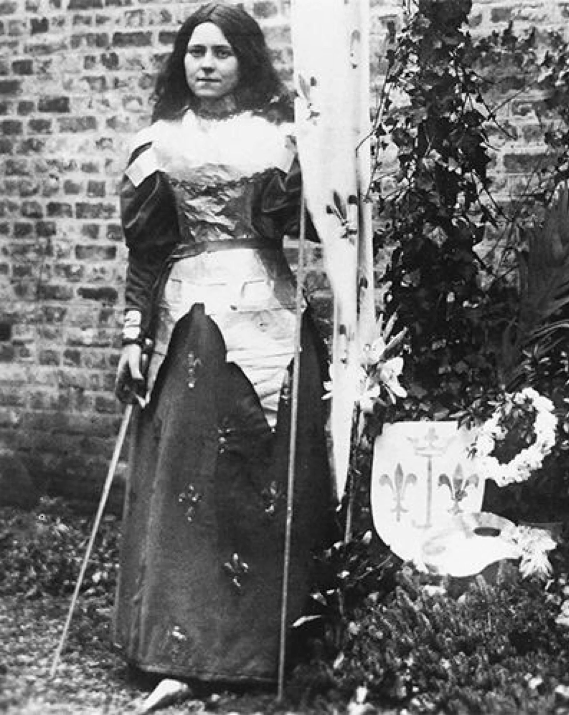
Universal Call to Holiness
“How monotonously alike all the great tyrants and conquerors have been; how gloriously different are the saints.”
– CS Lewis
John Paul II loved the outdoors
Bl. Carlo Acutis created websites for fun
St. Therese of Lisieux wrote and performed plays
Bl. Chiara Luce played tennis and loved to dance
Pope John XXIII was famously known for his humor
Notes:
Pictured: Bl. Carlo Acutis (to be canonized in April 2025), St. Thérèse of Lisieux dressed as St. Joan of Arc (bottom right), Pope St. John Paul II hiking in the mountains

Slide 8
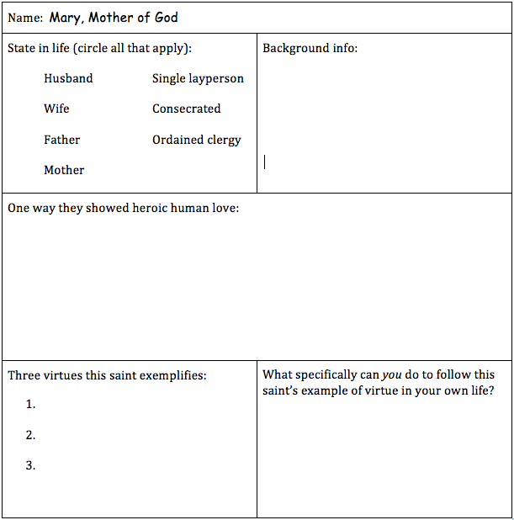

Slide 9
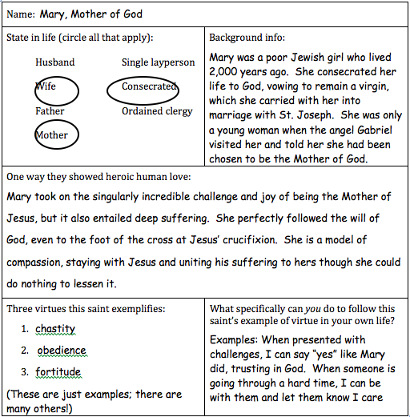

Slide 10
SAINT RESEARCH
Fill in the chart on the back of the sheet with information about your assigned saint and be prepared to share about him/her to the class.
Saint Elizabeth of Hungary
Saint Monica
Saint Gianna Molla
Saint Joseph
Saint Louis IX
Saint Thomas More
Saint Isidore the Farmer
Saints Zelie and Louis Martin
Saint Maria Goretti
Blessed Marie-Clémentine Anuarite Nengapeta
Saint Maximilian Kolbe
Blessed Carlo Acutis
Saint Augustine
Saint Mary of Egypt

Slide 11
Assessment
On a separate sheet of paper, write a one-paragraph response to the lives of the saints discussed today. It might be something you learned about one of them or something that inspires you.
Be specific and thorough.

