Slide 1
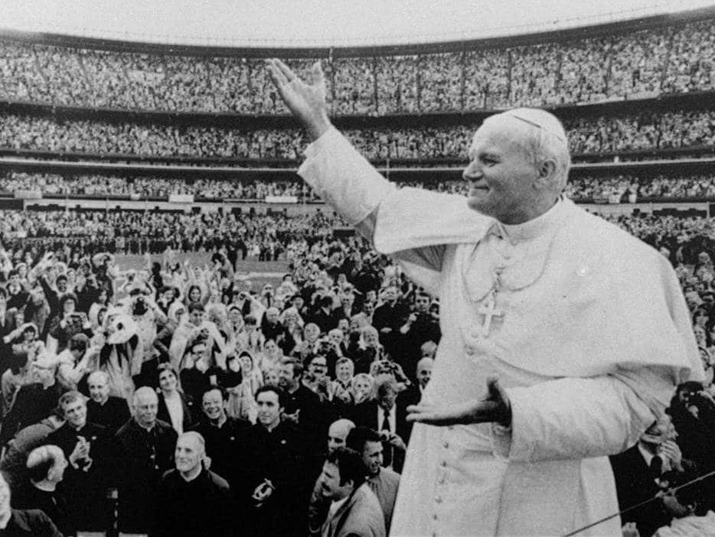
ENVISION: THEOLOGY OF THE BODY FOR MIDDLE SCHOOL
Seventh Grade Curriculum 8.3
Hope and Future: A Game Plan for Living Our Call to Love

Slide 2
Bellwork
Think about your hopes and dreams for the future. What kind of an education do you want? What about hobbies, jobs, and skills (like driving!)?
Answer the following questions with at least 4 details for each one:
  What are your goals for freshman year in high school?
  What are your goals for senior year in high school?
  What are your goals for 10 years from now?
  Ultimately, what do you want from life?

Slide 3
OPENING PRAYER
You are great, O Lord, and greatly to be praised:
Great is your power
And your wisdom is without measure.
And man, so small a part of your creation,
Wants to praise you:
This man, though clothed with mortality
And bearing the evidence of sin and the proof that you withstand the proud.
Despite everything, man,
Though but a small part of your creation,
Wants to praise you.
You yourself encourage him to delight in you
For you have made us for yourself,
And our heart is restless until it rests in you.
        -St. Augustine

Slide 4

Game plan for Chastity
Chastity is Critical to Meeting Your Goals
We can develop a good game plan for living our sexuality in a healthy way.

Slide 5

Pick a good team
Learn to tell the difference between true and superficial friendships.
Develop friendships with guys and girls who help you grow in holiness.
Look to young saints, like Bl. Pier Giorgio Frassati, Bl. Carlo Acutis, and St. Therese of Lisieux, for inspiration and ask them to intercede for you.
Share what is going on in your life with your parents or another trusted adult. Let them get to know your friends.
Develop closer relationships with Jesus, Mary, and St. Joseph.

Slide 6

Don’t go “out of bounds”
Dress, speak, and act modestly – respect yourself and others
Stay away from anything that promotes lustful attitudes, like porn and inappropriate literature, TV shows, social media, movies, and music
Be careful what you post and who you are friends with on social media. Don’t accept requests from people you don’t know.

Slide 7

Don’t go “out of bounds”
Refuse alcohol and drugs when offered – they mess up our ability to make good decisions and to resist peer pressure
Set appropriate boundaries and hold to them. Don’t try to arouse sexual feelings in others; instead, show affection for them.
Leave single dating for later years – enjoy getting to know both guys and girls in groups
Eventually when you date, go out with people who hold the same moral standards you do

Slide 8
What else would you add?
Look back at your lists from the activity in lesson 5: is there anything else you would add?

Slide 9
“Condition” for Success
Pray, pray, pray. Ask God for guidance and strength and develop the habit of spending 10 minutes each day talking to Him about what is going on in your life.
Go to Reconciliation for the grace to resist temptation and the forgiveness we need when we sin.
Receive the Eucharist regularly. Christ gives himself to us completely in this sacrament. We can learn self-giving love, too, with His help – this is the essence of chastity!
Practice the Works of Mercy and look for daily ways to make a gift of yourself.

Slide 10

PRAYER & COMMITMENT

